Slide 1
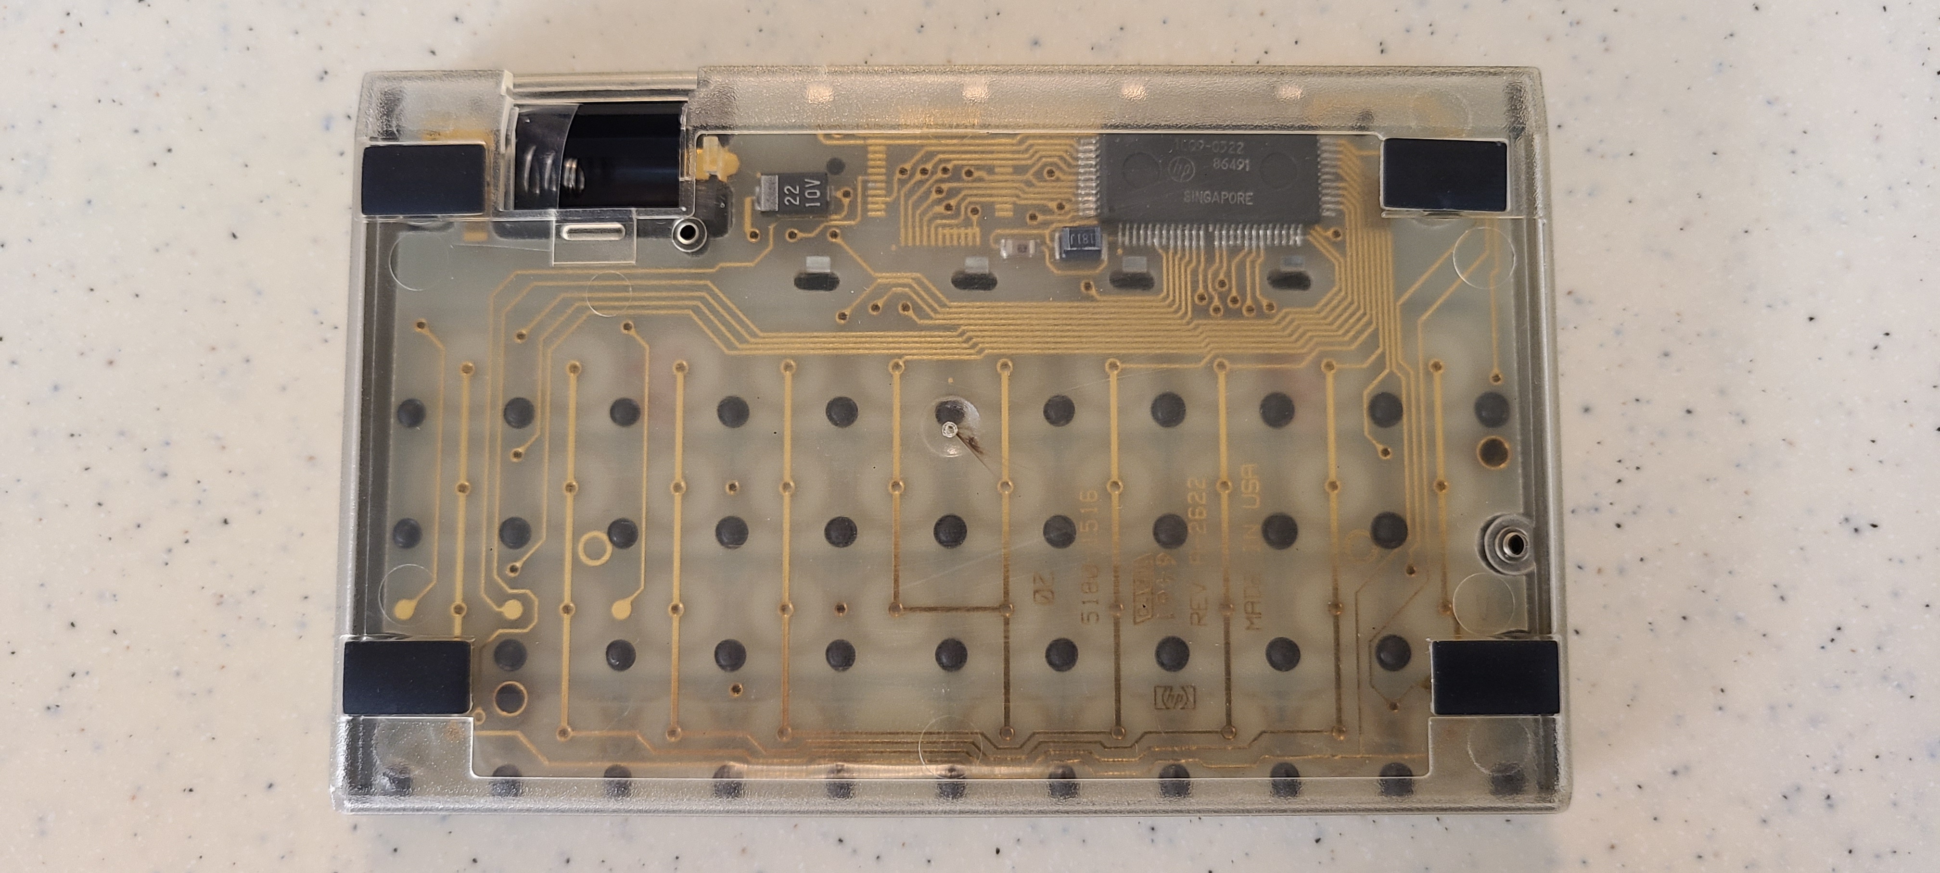
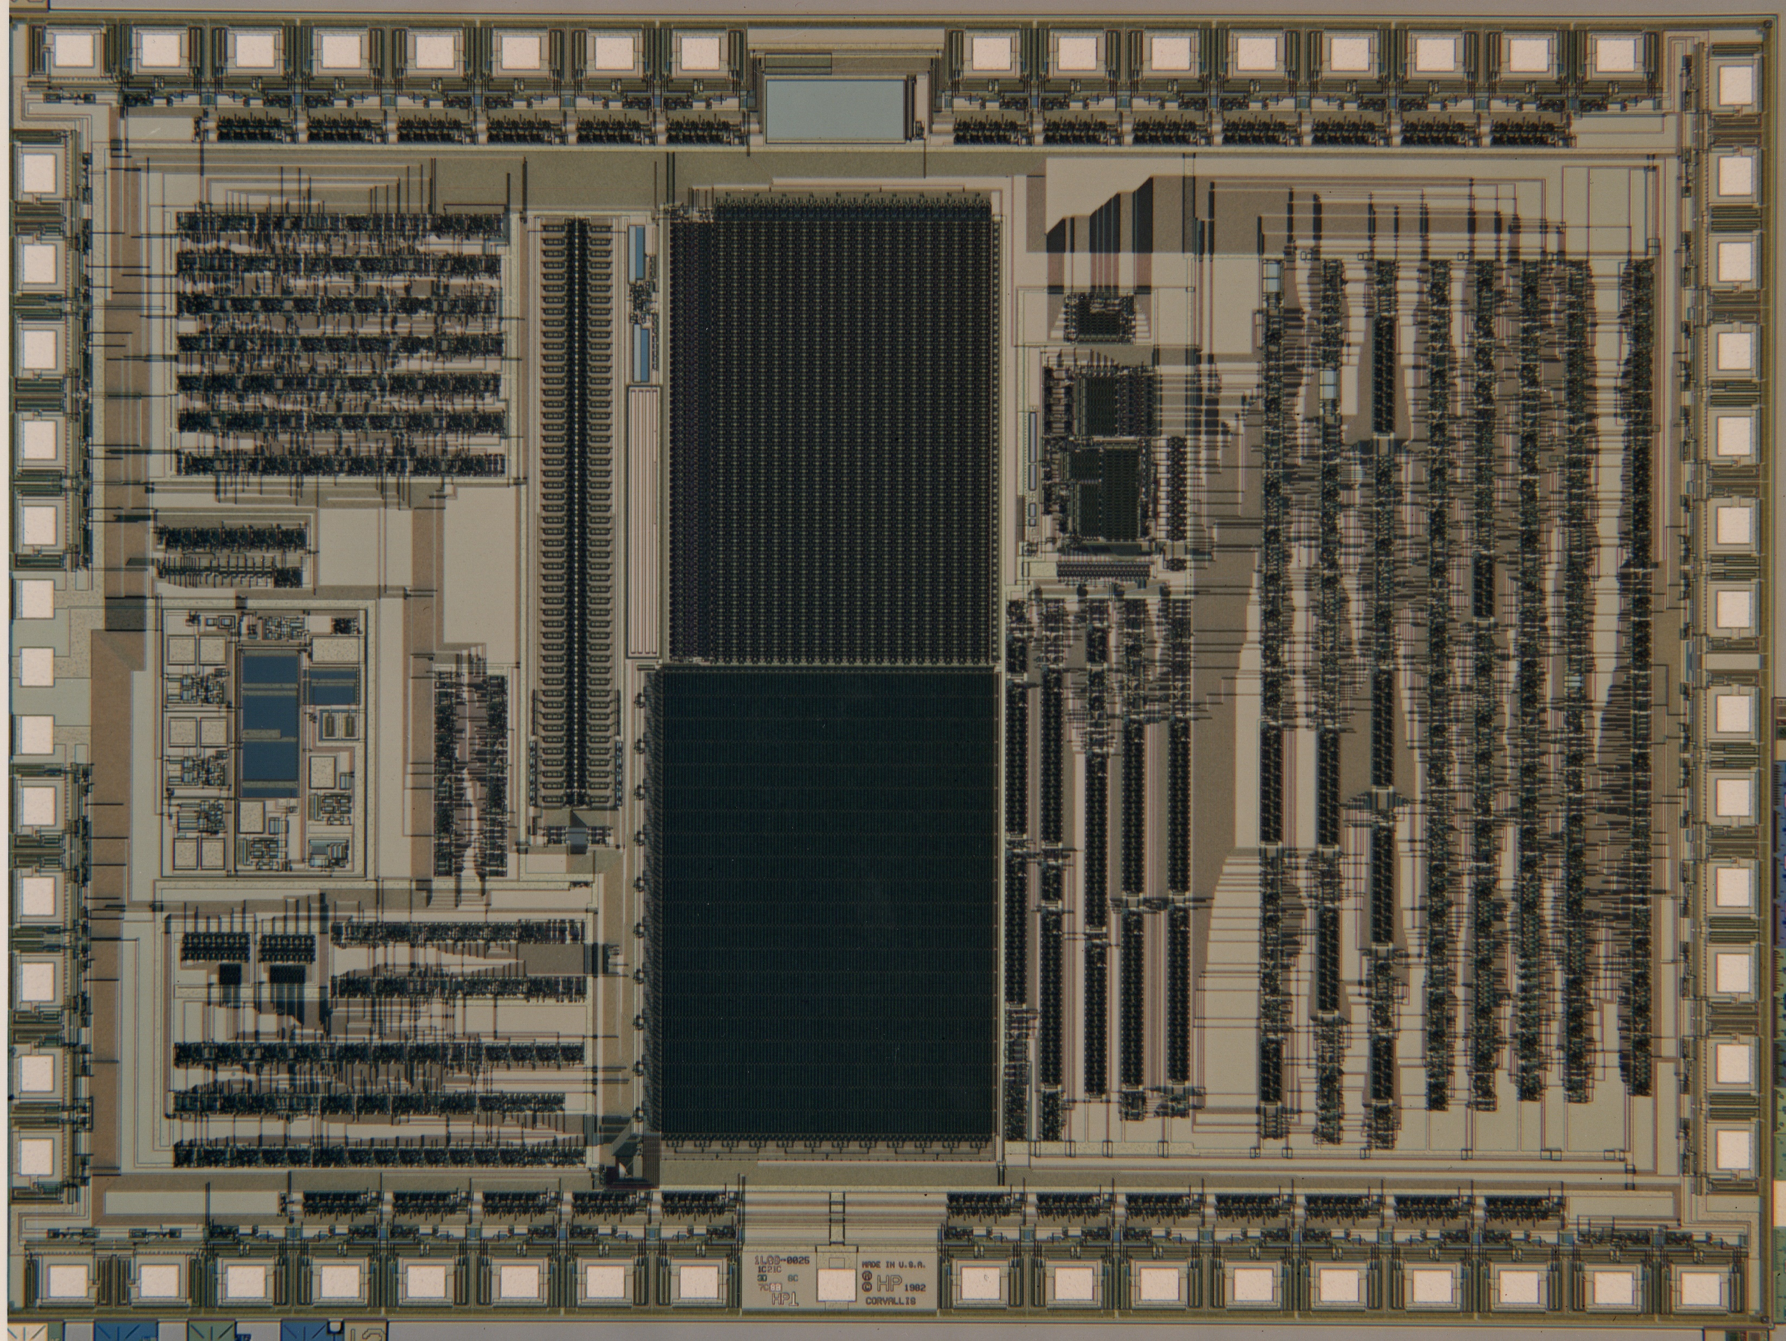
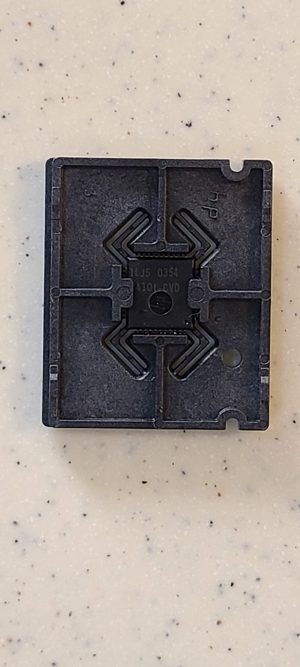
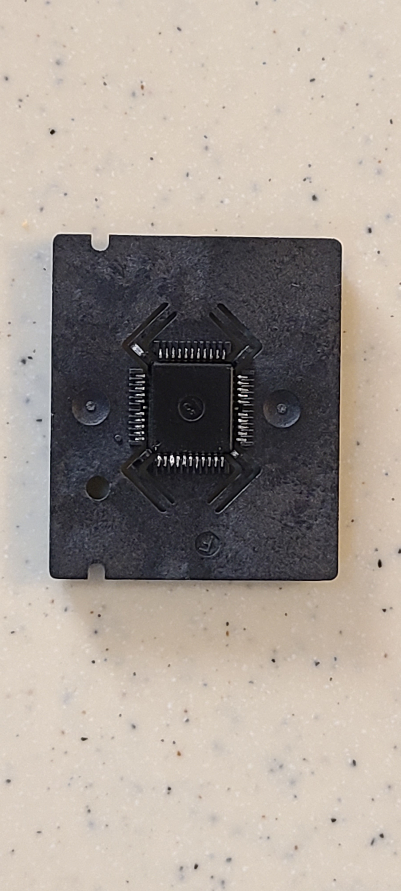
Single Chip Series Ten (SST)
Chuck McCord

Slide 2
Outline
Voyager Context/Challenges
What is SST
  Project goals
  HP organization context
    Corvallis Site
      ICBD History
      Why Corvallis
      Calculators, Portable Computers, Components
    Return of the Jedi
  IC
    Design team
    Design description
    Design Process
    Verification
  Project surprises
  Summary
  Epilogue –then & now
    Post SST: HP12C,DM12L
    Semiconductors
    HP Site
Notes:
We’ll start with voyager context to highlight challenges
Talk about SST goals
The organization context
Relate it to Return of the Jedi
Talk about the IC design team, design, development process, and verification
Present some of the project’s surprises
If we have time we’ll talk about HP Semiconductors and the HP Corvallis site then and now

Slide 3
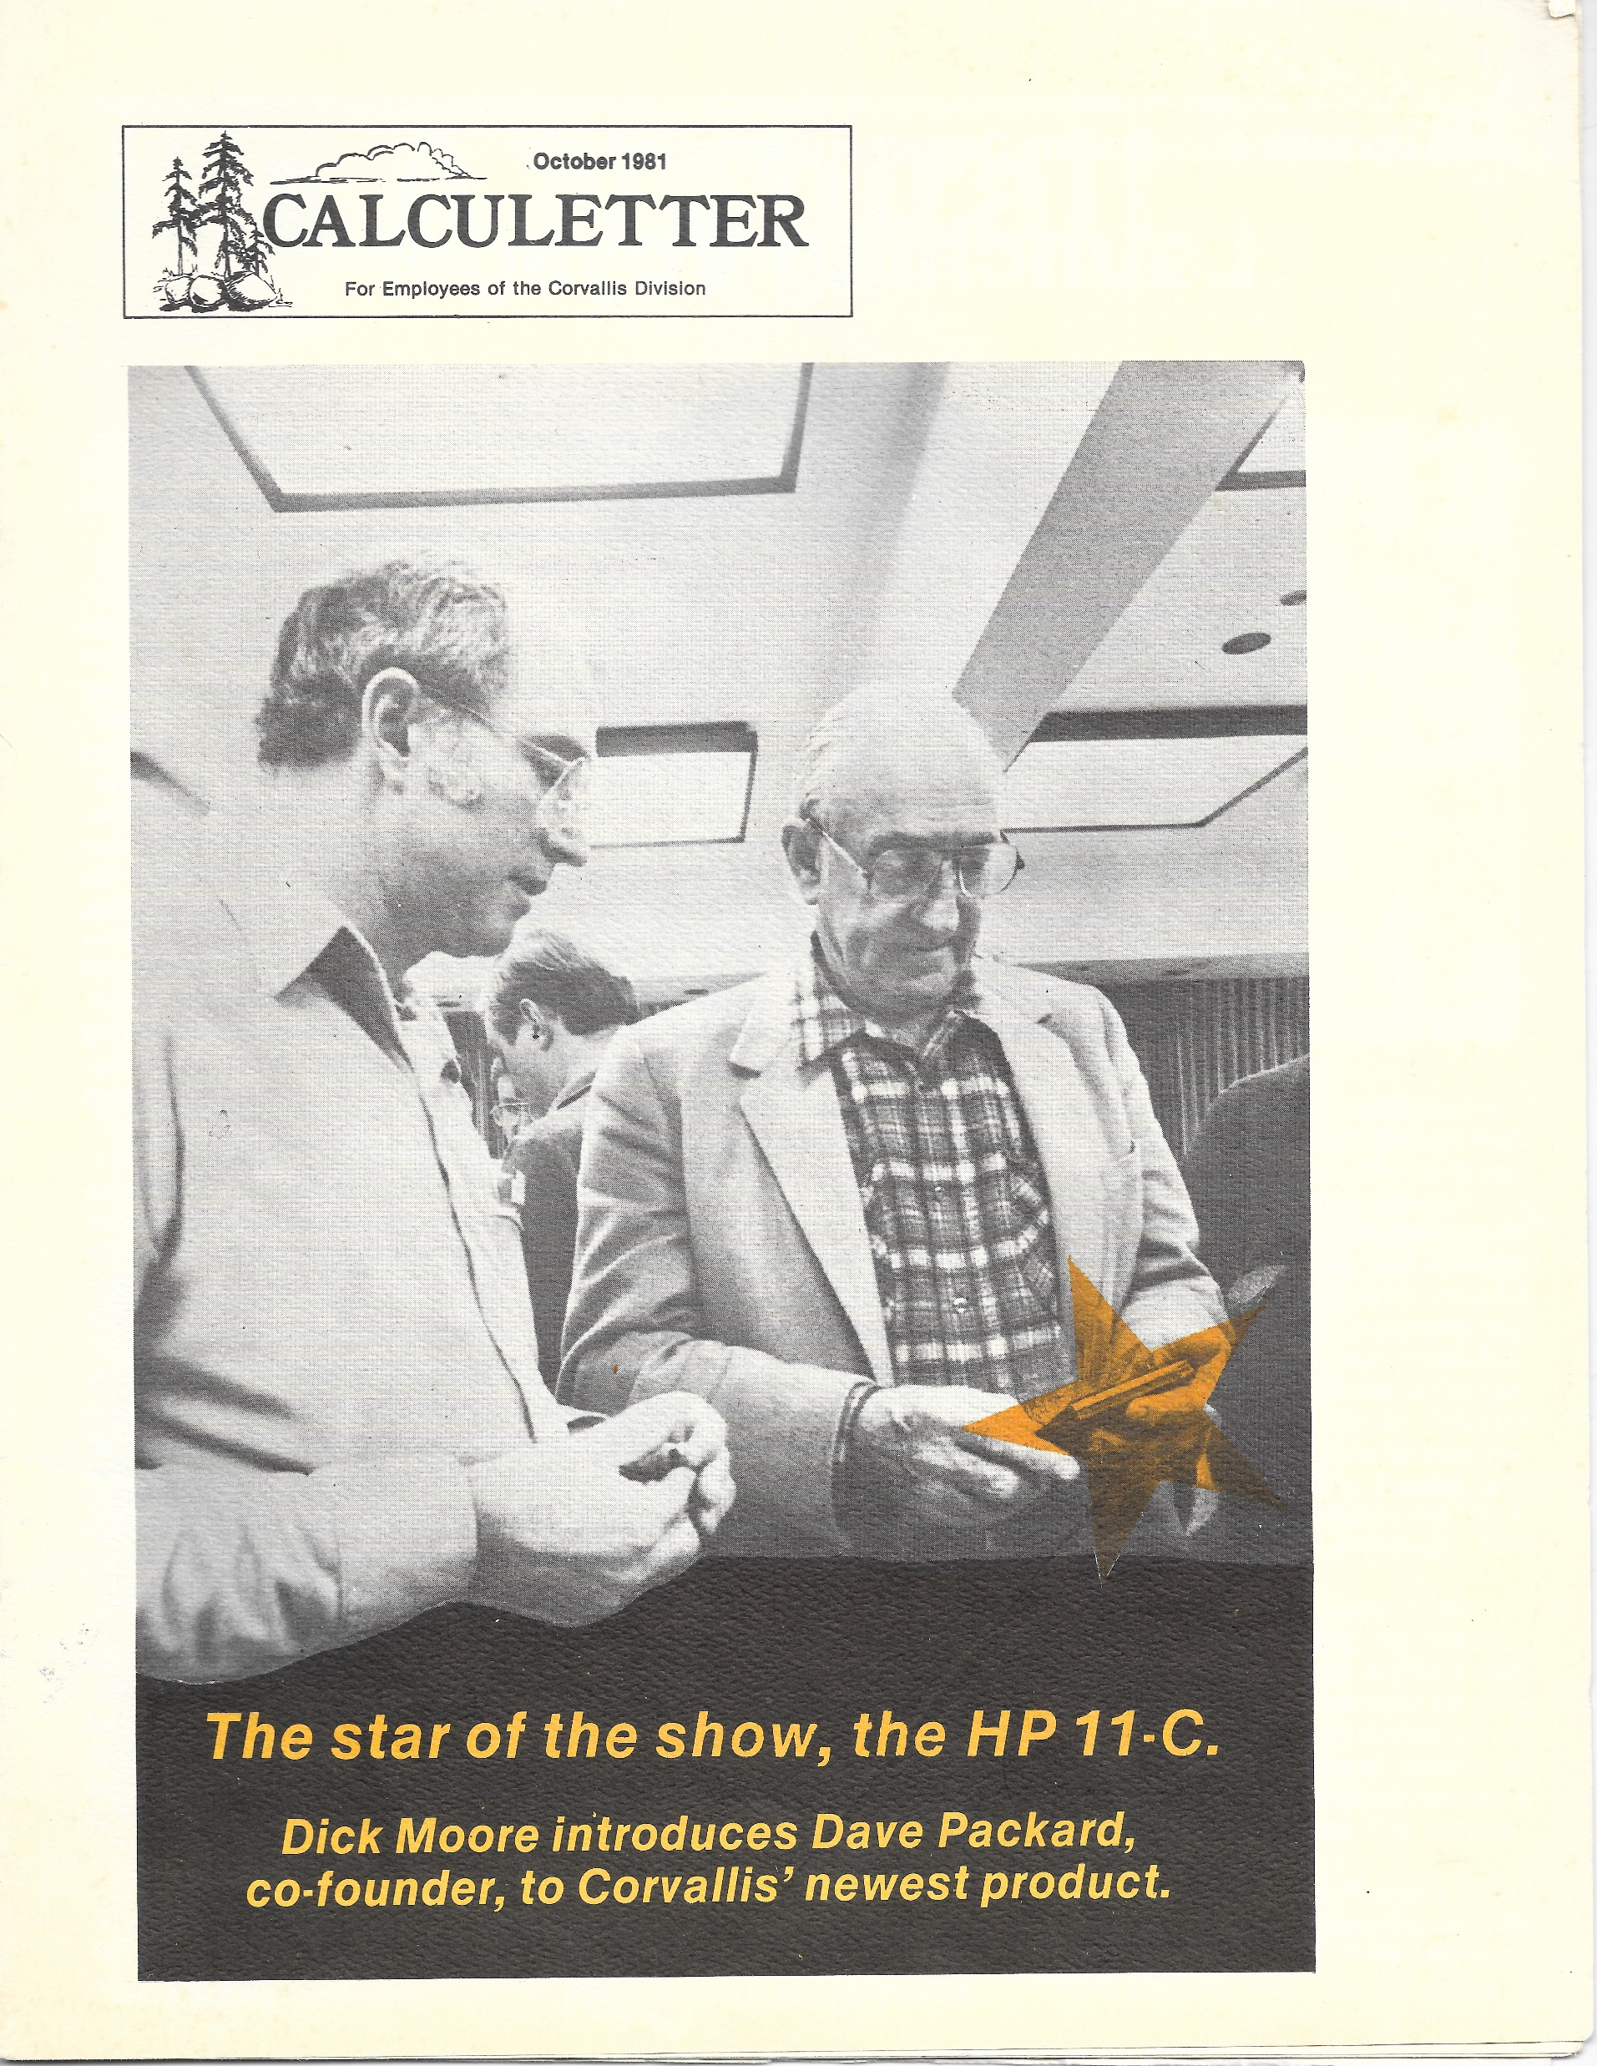
Notes:
Voyager was a big deal for Corvallis
In this employee newsletter cover picture with David Packard, the “star of the show” is the HP11c.
An internal article notes the TV press and trade magazine coverage.

Slide 4
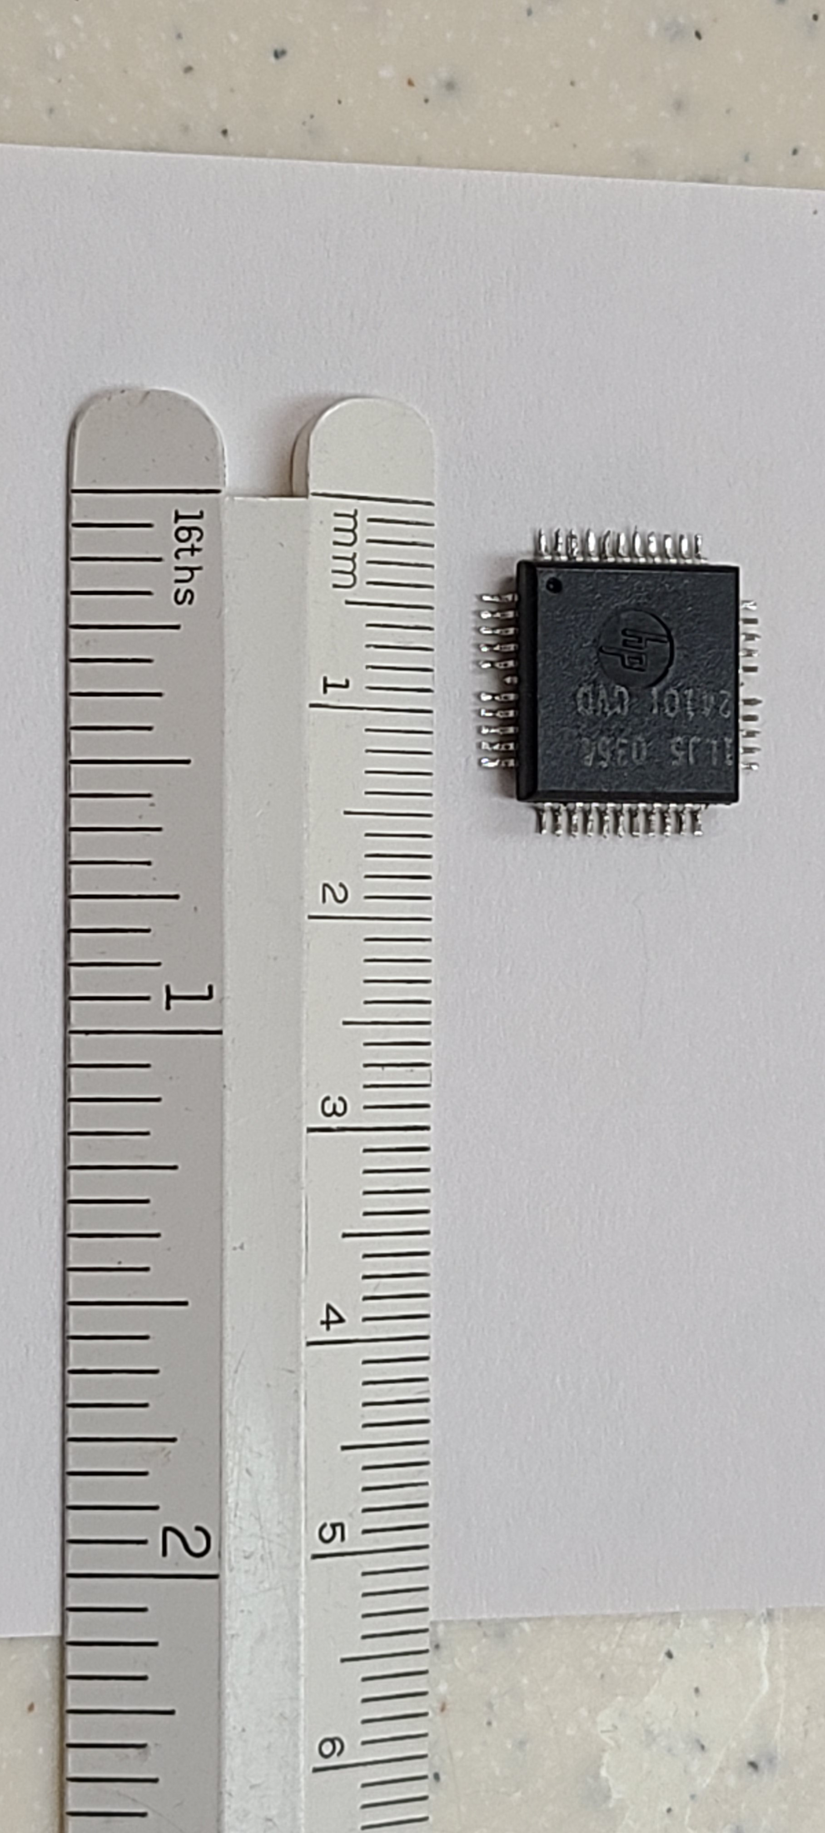
Voyager’s two major challenges for the Corvallis Components Operation
44p QFP
High pinout Quad Flat Pak (QFP) package
Voyager required the largest CMOS chip yet done in our shop … “even though this is too big for large scale production in our present CMOS process, we built tens of thousands of these circuits and made introduction of the new calculators possible months earlier…”
“Our new, higher density MOS process will be starting up early next year and will make our in-house capability cost effective”
Notes:
Inside the cover the message from Ed Schideler highlights the 2 major challenges of Voyager.

Slide 5
SST Project Goals
Voyager doing well
Voyager was high volume (for HP)
Wanted to cost reduce Voyager
  Reduce number of ICs from 2 to 1 for HP10, HP11, HP12, HP16 and
  Reduce number of ICs from 3 to 2 for HP15
  Use a 2 layer PCB
SST viewed as a short term cost reduction as Voyager would be replaced by Pioneer with 1-2 years

Slide 6
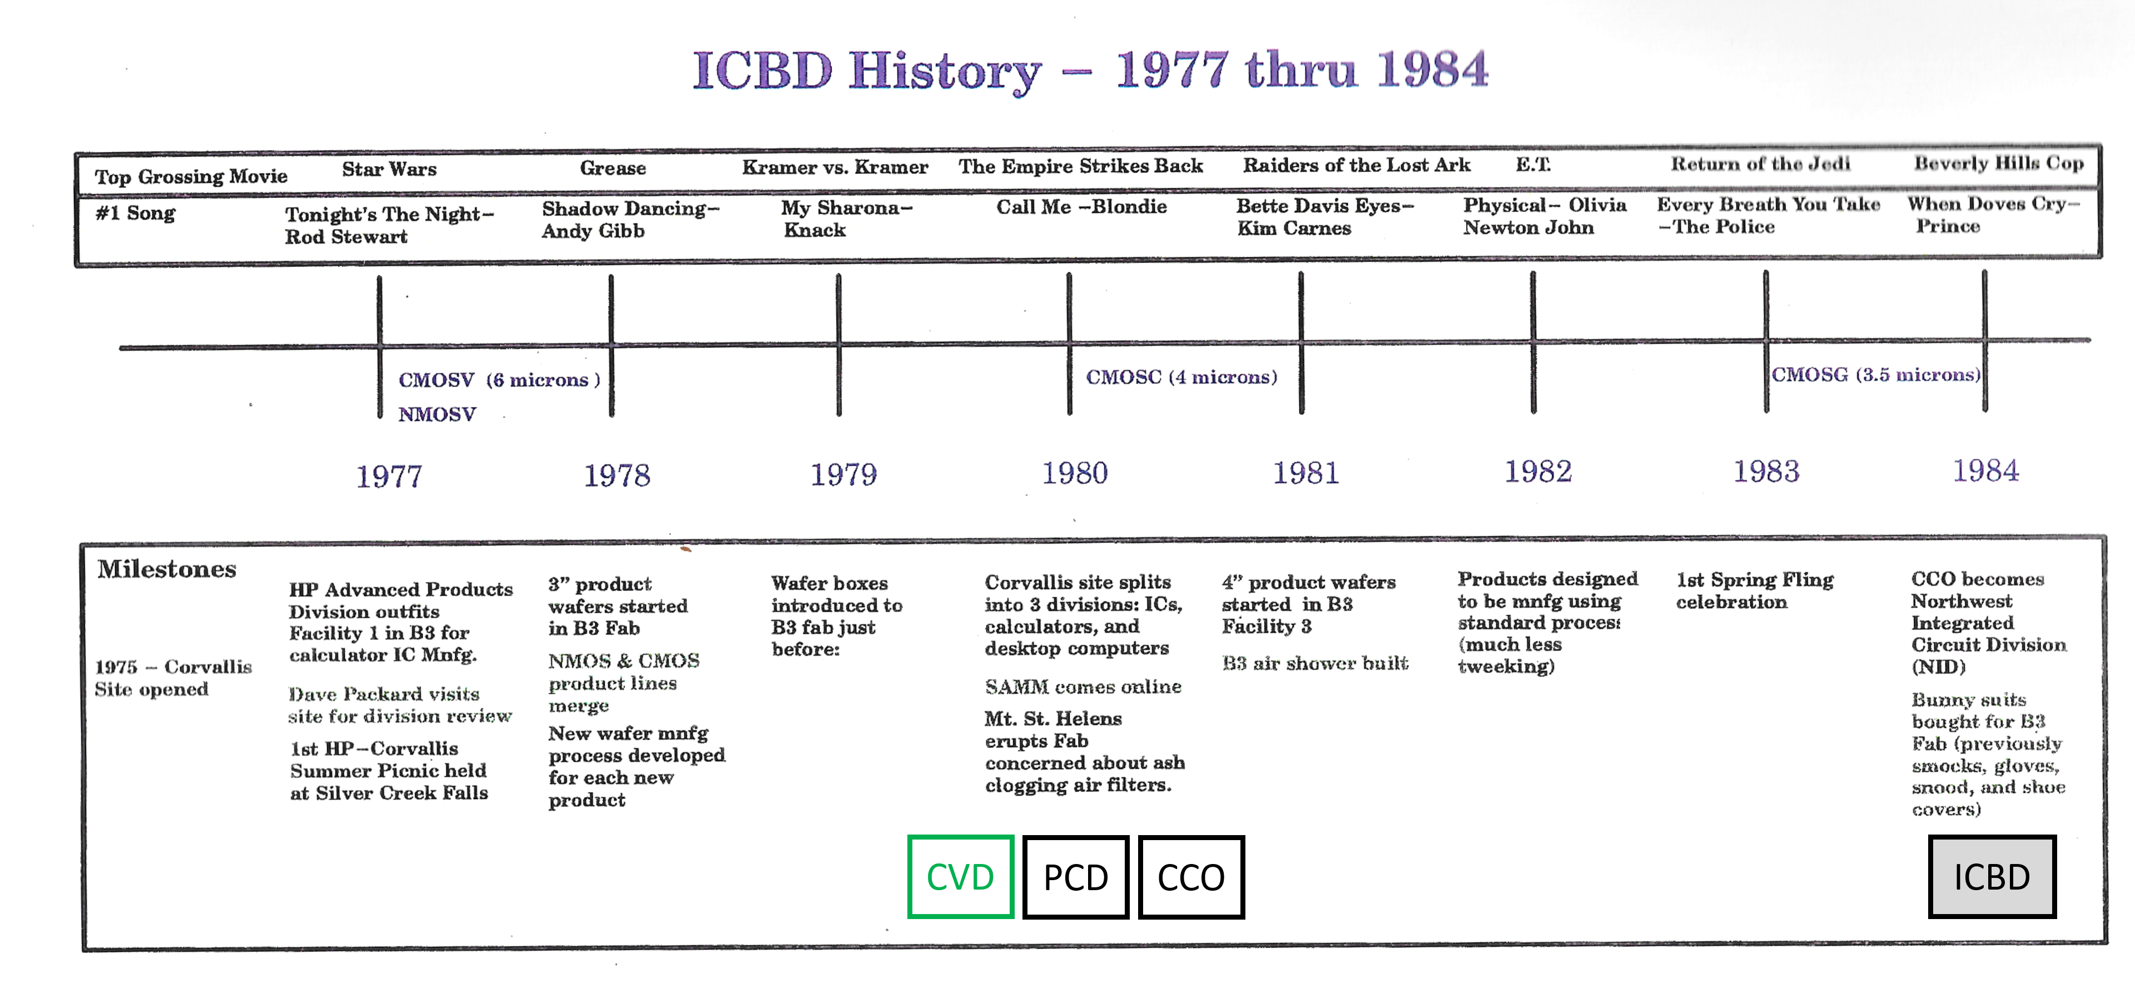
Why Corvallis?
Corvallis CMOS Fab
Notes:
1976 Corvallis site opened. Why Corvallis? OSU, John Young OSU grad, CV a good place for a CMOS fab for calculators
CMOS fab not SOS
-low operating current
-ultra low leakage
-low cost (not high performance)
1980 Split into separate operating entities

Slide 7
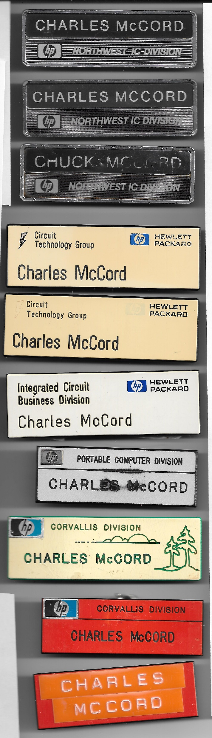
HP FABs consolidated into CTG
HP Organizations
From my vantage point
CTG created from:
ICBD/NID- NW IC Division
FID- Ft Collins IC Division
CID- Cupertino IC Division
CCO becomes NID (1984)
SST
ICBD created(1990)
BU doing ICs for many HP Divisions
CVD
PCD
CCO
1980
t
Notes:
HP Organization from my perspective – all of my “gum pack” badges
I joined Corvallis Division in 1980. I worked on the HP75 then the HP75 expansion pod.
When I joined NW IC division as the SST IC project manager the project was already underway and behind schedule

Slide 8
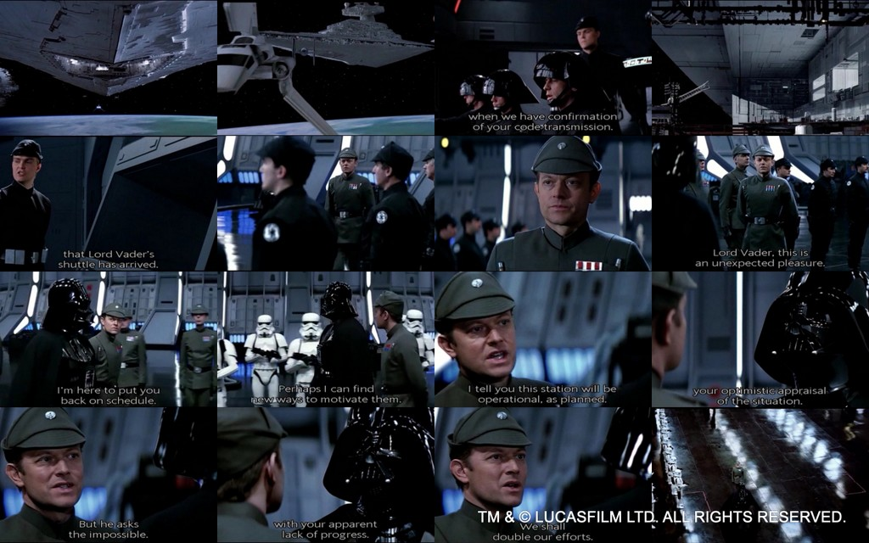
Notes:
So why do I think of Return of the Jedi when I think about SST?
Remember at the beginning of the movie Darth Vader lands on the incomplete Death Star 2 and is greeted by the station commander…

Slide 9
SST
Behind schedule before it started
Program manager: “Lord Vader, this is an unexpected pleasure! We are honored by your presence.”
Vader: “You may dispense with the pleasantries commander. I am here to put you back on schedule!”
PM: “I assure you Lord Vader, my men are working as fast as they can.”
Vader: “Perhaps I can find new ways to motivate them.”
PM: “I tell you, this station will be operational as planned.”
Vader: “The emperor does not share your optimistic appraisal of the situation.”
PM: “But he asks the impossible! I need more men.”
Vader: “Then perhaps you can tell him when he arrives.”
PM: “The emperor is coming here?”
Vader: “That is correct, commander… And he is most displeased with your apparent lack of progress.”
PM: “We shall double our efforts!”
Vader: “I hope so commander, for your sake. The emperor is not as forgiving as I am.”
TM & © LUCASFILM LTD. ALL RIGHTS RESERVED.
A Tale about a Failed Project: The Death Star II program
by Christophe Achouiantz
Notes:
Read the dialog!
As my first project as project manager coming in to a project that was behind schedule I sometimes felt like Vader and sometimes like the station commander.
Note this is courtesy of a project management web site :-)

Slide 10
SST’s International Design team
Matt Borg
Allen Brown
Ray Davis
Don Reid
Eric Gullerude
Chuck McCord
Corvallis team- couldn’t have asked for better…
very strong EEs with calculator system backgrounds
  HP41 CPU designer
  Voyager IC designers
Singapore team- extended FSEs in Corvallis
  Awesome group of BS, MS EEs that went on to be
    HP/Agilent Penang site R&D Manager
    HP Singapore site R&D Manager
    Engineers, Directors & VPs at HP and other companies
We worked long hard hours. We had a blast. We formed friendships that lasted decades.
Frederick Cheong
Pan Kok-Chin
Pang Chong
*
* Profuse apologies to any left out… it wasn’t intentional. These are those that I and the 3 team members I contacted could remember from 40 years ago.
Notes:
End with this is the best recollection for 3 of the team that worked on the project, we know we are missing at least one person…

Slide 11
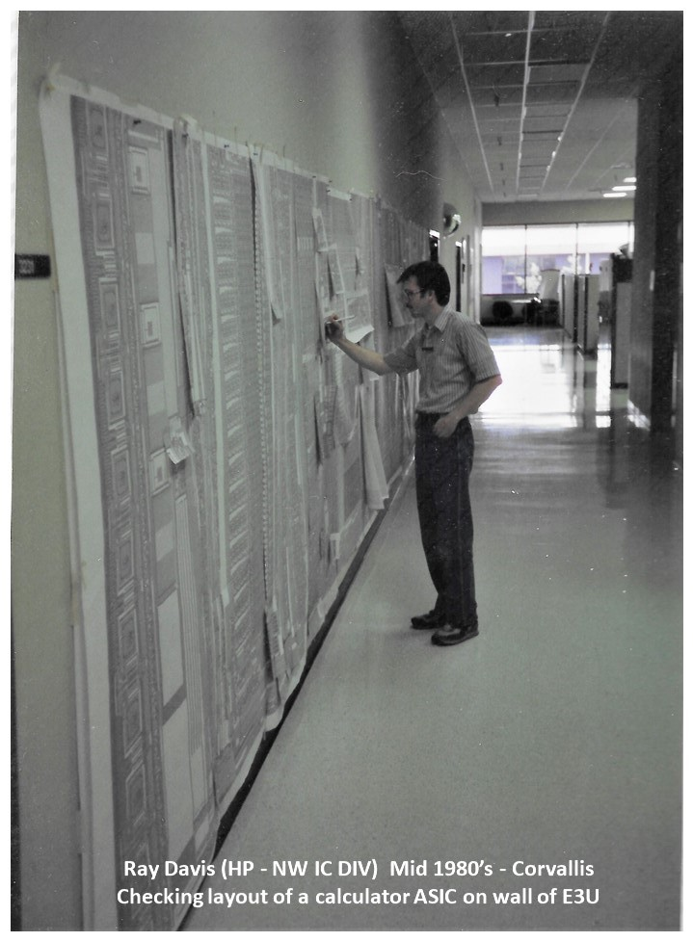
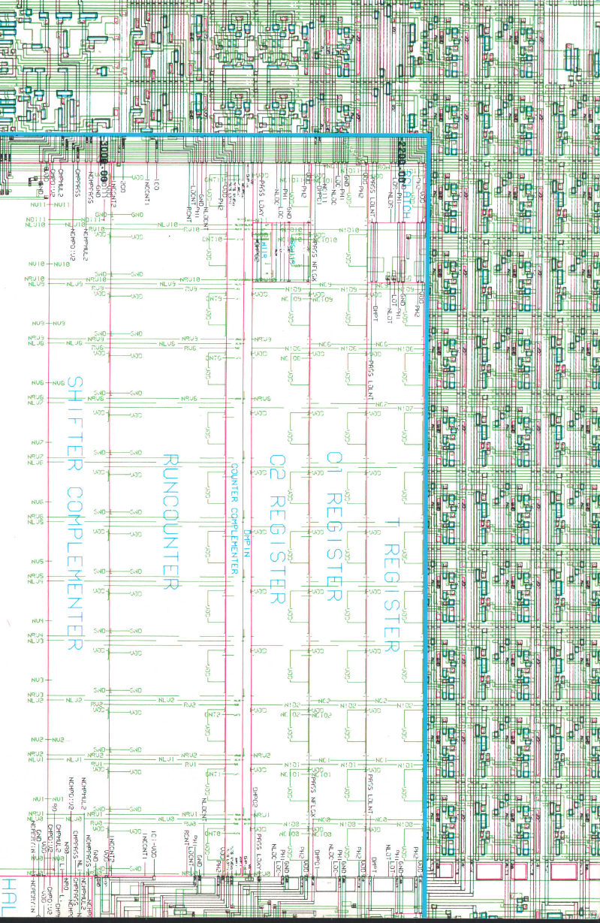
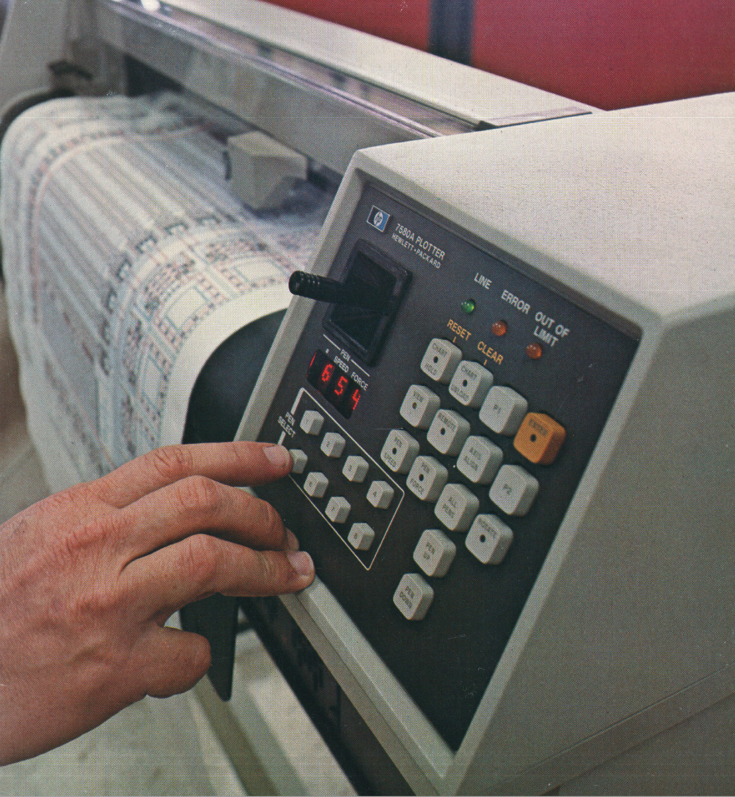
SST’s Design
Voyager schematic hand drawn on 1 E-size blueline (key tool used is pictured)
All previous designs were full chip custom layout
  There was a fair amount of skepticism that standard cells could achieve cost effective densities for high volume calculator designs (i.e., were CAD tools capable of achieving cost effective densities in current CMOS processes).
The SST design was partitioned into custom blocks and standard cells
  Used custom cells for density: RAMs, ROMs, Shift registers, PLAs, Analog
  Entered schematic for Standard Cells.

Slide 12

SST
(Single Chip Series 10)
Design Description
Single Superchip for
HP10,11,12,16
HP15 2 chip implementation
First HP standard cell CMOS calculator IC

Slide 13
SST
(Single Chip Series 10)
Design Description
CPU
- PLA
- Standard Cells
- Registers
RAM
ROM
LCD Display Driver
Keyboard Interface
Clock generation
Coupling
CAP
Drivers
Pad out order routed to enable 2-layer PCB
ESD
Latch-up
Protection
RAM
Display Shift Register
PLA
Analog
FFs
ROM
M
©

Slide 14
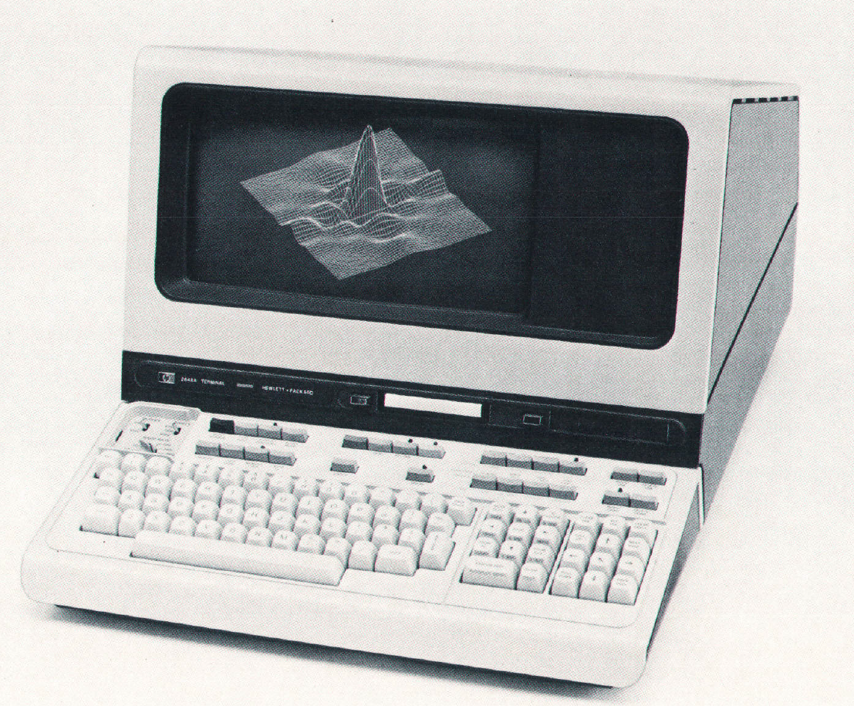
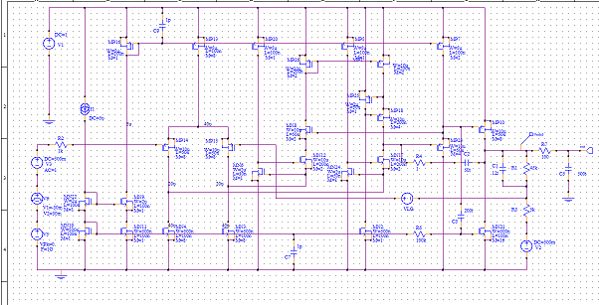
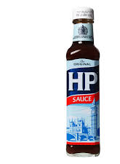
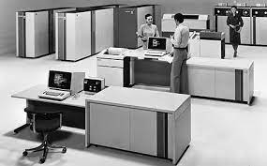
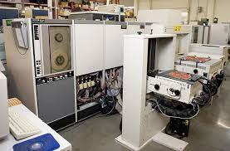
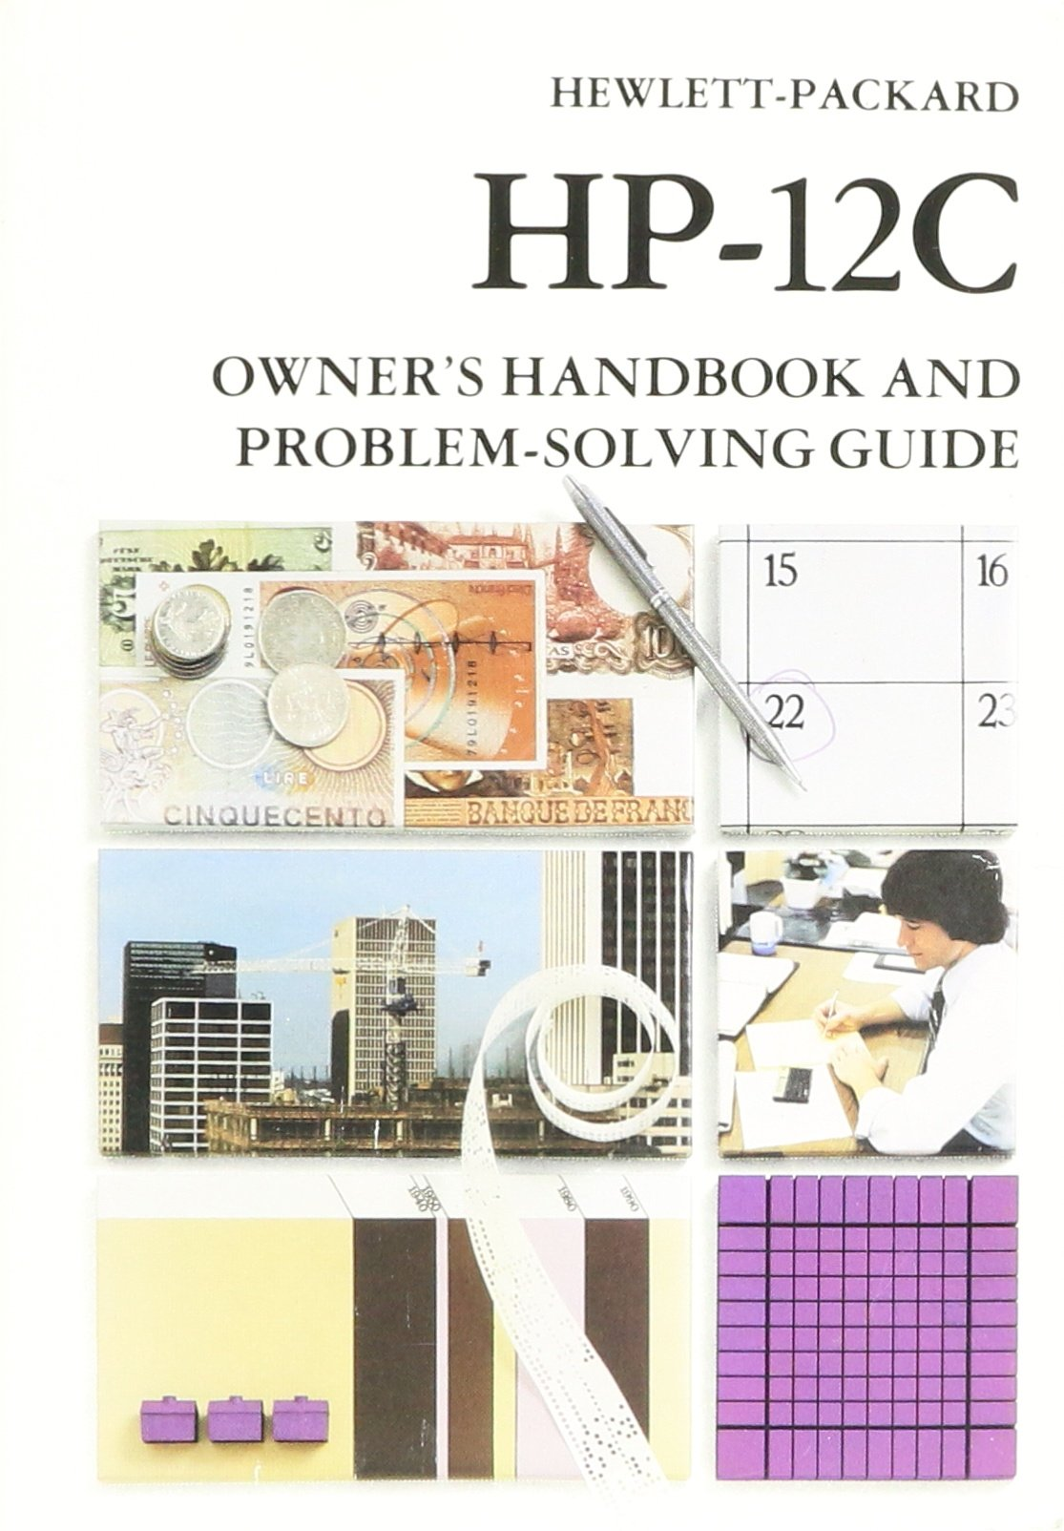
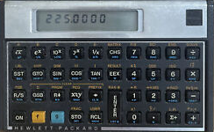
Verification
During design:
Simulation-Used Voyager functional test vectors to logic simulate full chip
Voyager – very high quality low PPM
HP SPICE simulated custom cells, critical timing paths
SCOPE – Sandia Controllability and Observability program used to evaluate testability
DRC, LVS- run on Amdahl in Loveland, Colorado
During manufacture:
ATE- Schlumberger Sentry 7, Sentinel testing- full pattern, electrical spec testing
Did multipattern RAM retention testing
ROM verification
Prototyping:
Did large proto builds (had people on site run units thru paces)
Also had technicians verify every user manual example for all models
⊗

Slide 15
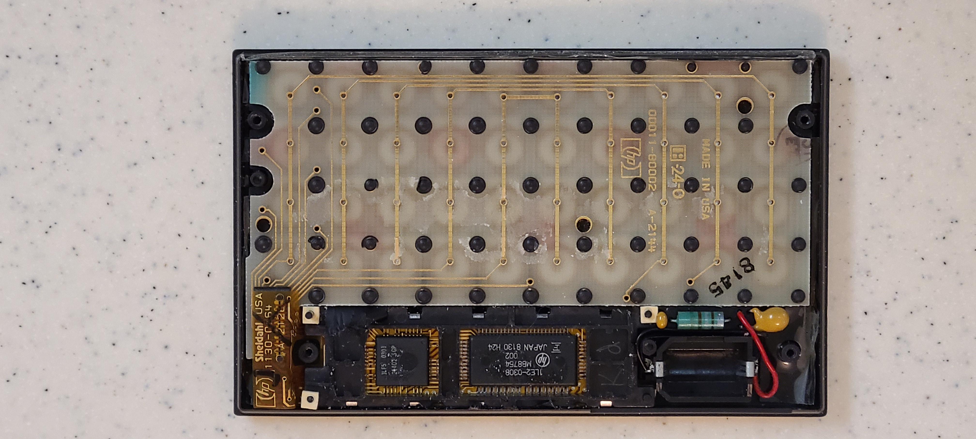
Keep-Alive
Capacitor
Oscillator
Resistor, Capacitor
ROM,RAM,
Keyboard, Display
CPU
Voyager System
HP10, HP11,HP12
(2) ICs
(2) PCBs
  1 Higher cost
Plastic Dam
PCB-PCB connection
Wires
Non-surface mount R and Cs
* Big THANK YOU to Bob Prosperi for this photo!
ESD
Spring
Notes:
The voyager system was more integrated than previous calculators. No chip on board hybrids.
But it still had multiple Ics
2 PCBs, electronics are on polyimide.
PCB to PCB connections
Wires
Non surface mount
Thank you to Bob for this photo!

Slide 16
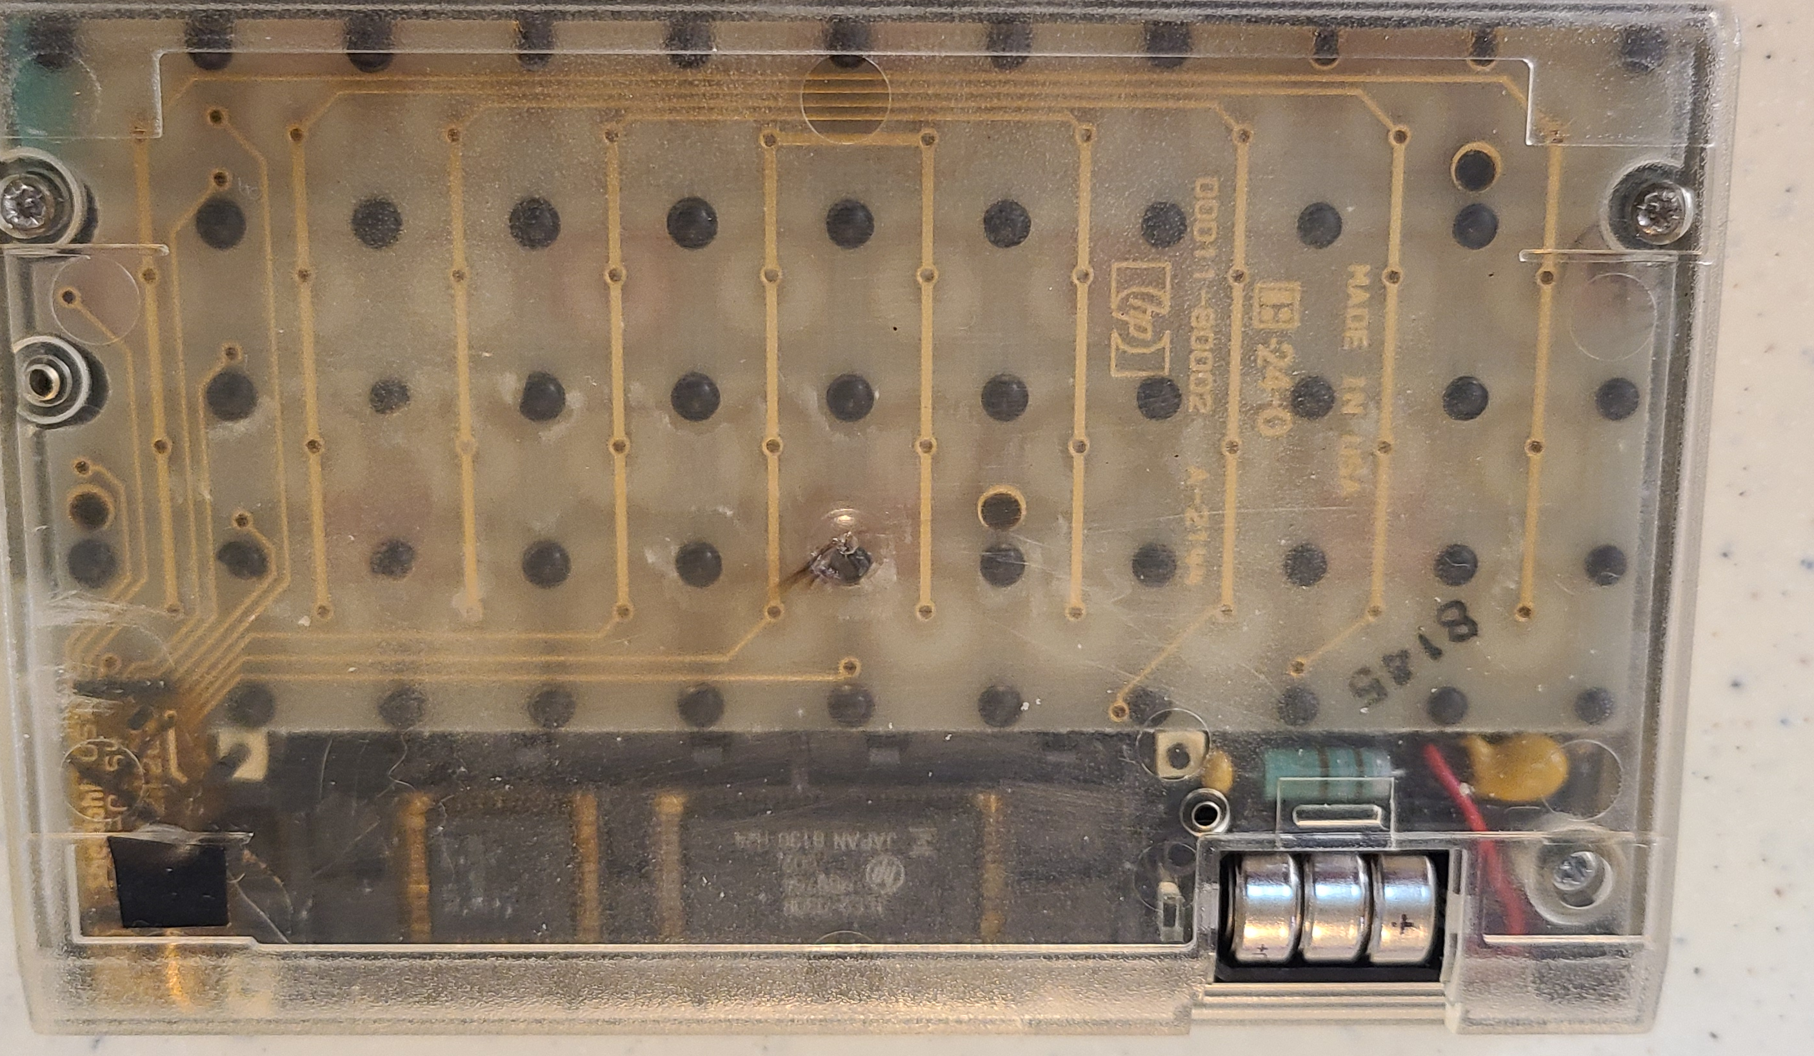
Oscillator
Resistor, Capacitor
ROM,RAM,
Keyboard, Display
CPU
Voyager System
HP10, HP11,HP12
Keep-Alive
Capacitor
(2) ICs
(2) PCBs
  1 Higher cost
Plastic Dam
PCB-PCB connection
Wires
Non-surface mount R and Cs
ESD
Spring
* Big THANK YOU to Bob Prosperi for this calculator!
Notes:
The voyager system was more integrated than previous calculators. No chip on board hybrids.
But it still had multiple Ics
2 PCBs, electronics are on polyimide.
PCB to PCB connections
Wires
Non surface mount
Thank you to Bob for this calculator!

Slide 17
SST Voyager System
HP10, HP11, HP12
SST
(72p QFP)
Keep-Alive
Capacitor
Oscillator
Resistor, Capacitor
(1) IC
(1) 2 layer PCB
No Plastic Dam
No PCB-PCB connection
No Wires
All surface mount R and Cs
ESD
Spring
Notes:
This is an SST voyager system - read the list read the blue items

Slide 18


Project Surprises
Big one- HP12 was not obsoleted by Pioneer & is still going strong. The SST project had a very positive ROI. The HP12 outlasted its fab process. SST SST was not the last Voyager reimplementation.
How much less robust semi-custom auto place and routed designs were than their original custom designs.
  When all appropriate parasitic were considered HP Spice was reliably spot-on accurate. Simplifying assumptions led to missed timing races and voltage dependent behaviors.
One example found late in development was the ON-. Timing race.
3,1,4,1,5,9,2,6,5,4,

Slide 19
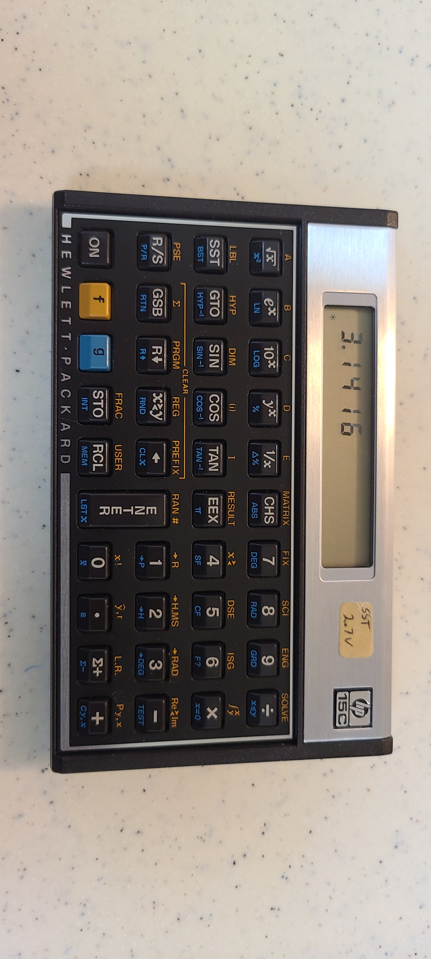
Notes:
This is a marginal prototype- any guesses why it is working?

Slide 20
Notes:
Un-hiding the label- any ideas WHY it is working?
Any ideas HOW it is working?

Slide 21
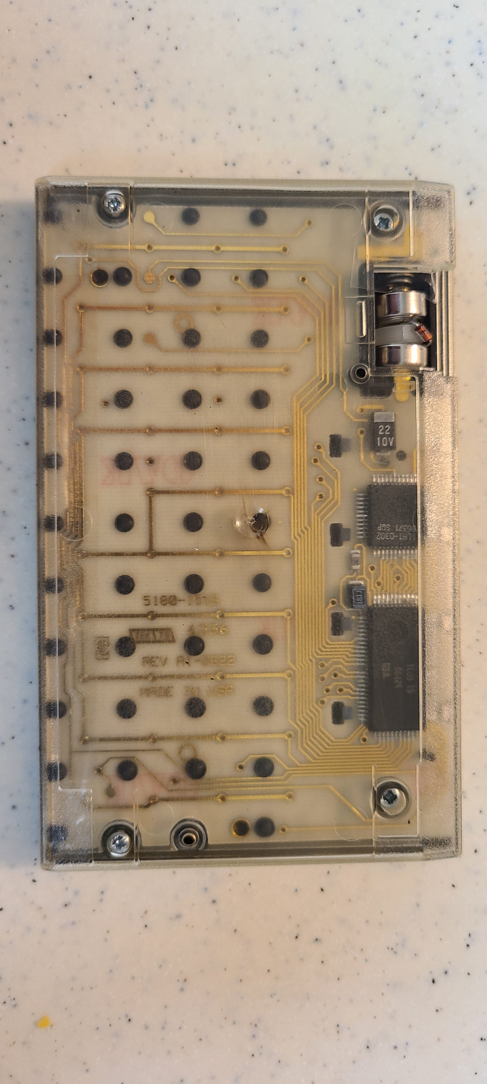
Voyager System
HP15
15C
2ndROM
Keep-Alive
Capacitor
Oscillator
Resistor, Capacitor
SST
4 screws
Under pads
Notes:
Looking at the back of the marginal unit, it’s a 15 so it has a second IC.
Let’s zoom in for a closer look at the battery compartment

Slide 22
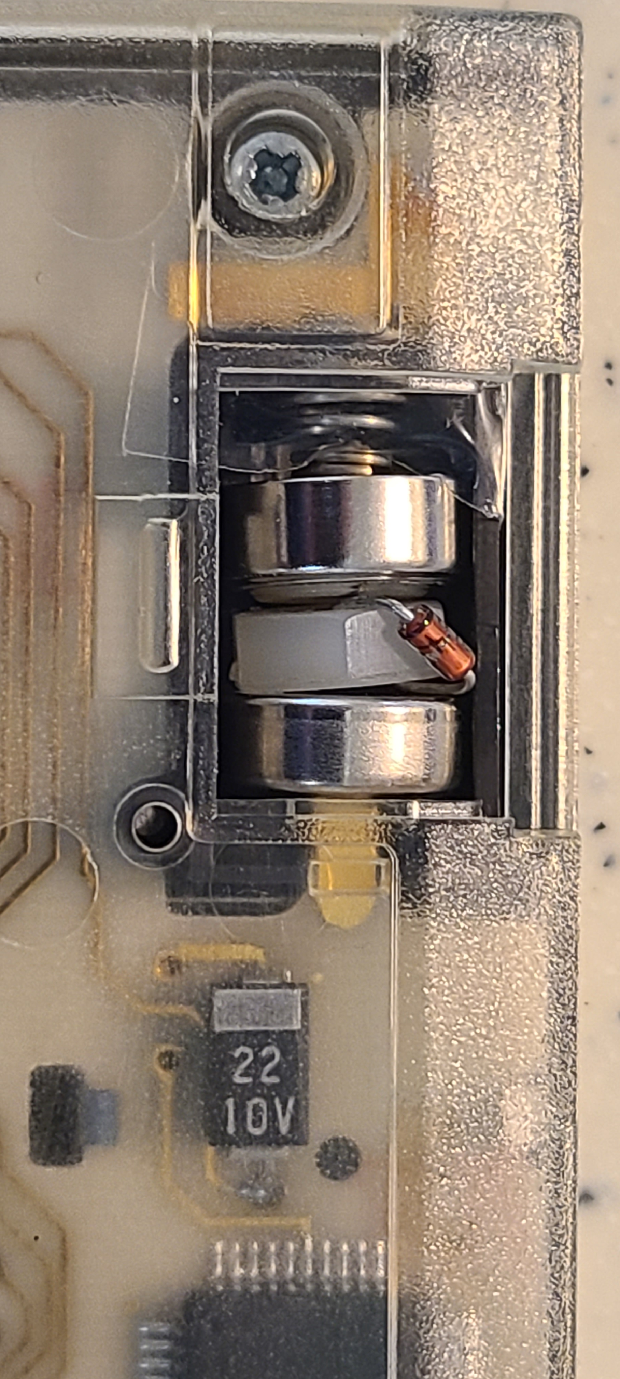
Voyager System
Low Voltage Workaround
Notes:
In the middle, that’s a nylon washer with a diode draped over it
1.5+1.5- diode drop gets us to a working low voltage

Slide 23
Summary
Voyager Context / Challenges
What is SST
  Project goals
  HP organization context
    Corvallis Site
      ICBD History
      Why Corvallis
      Calculators, Portable Computers, Components
    Return of the Jedi
  IC
    Design team
    Design description
    Design Process
    Verification
  Project surprises
  Summary
  Epilogue –then & now
    Post SST: HP12C,DM12L, series
    Semiconductors
    HP Site
TM & © LUCASFILM LTD. ALL RIGHTS RESERVED.
Thank You!!
3,1,4,1,5,9,2,6,5,4,

Slide 24
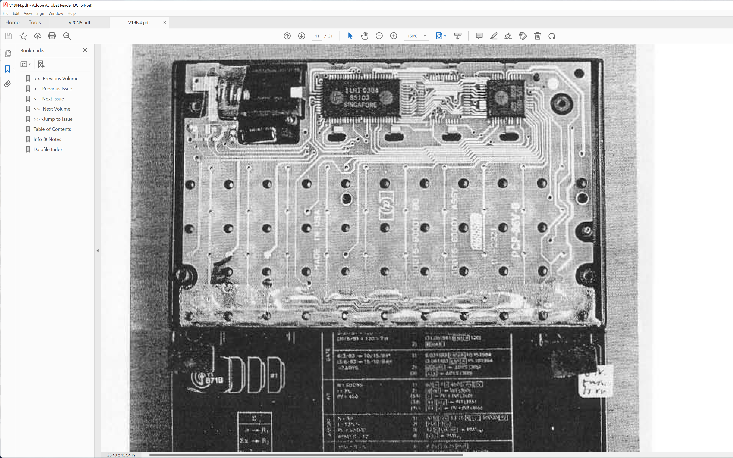
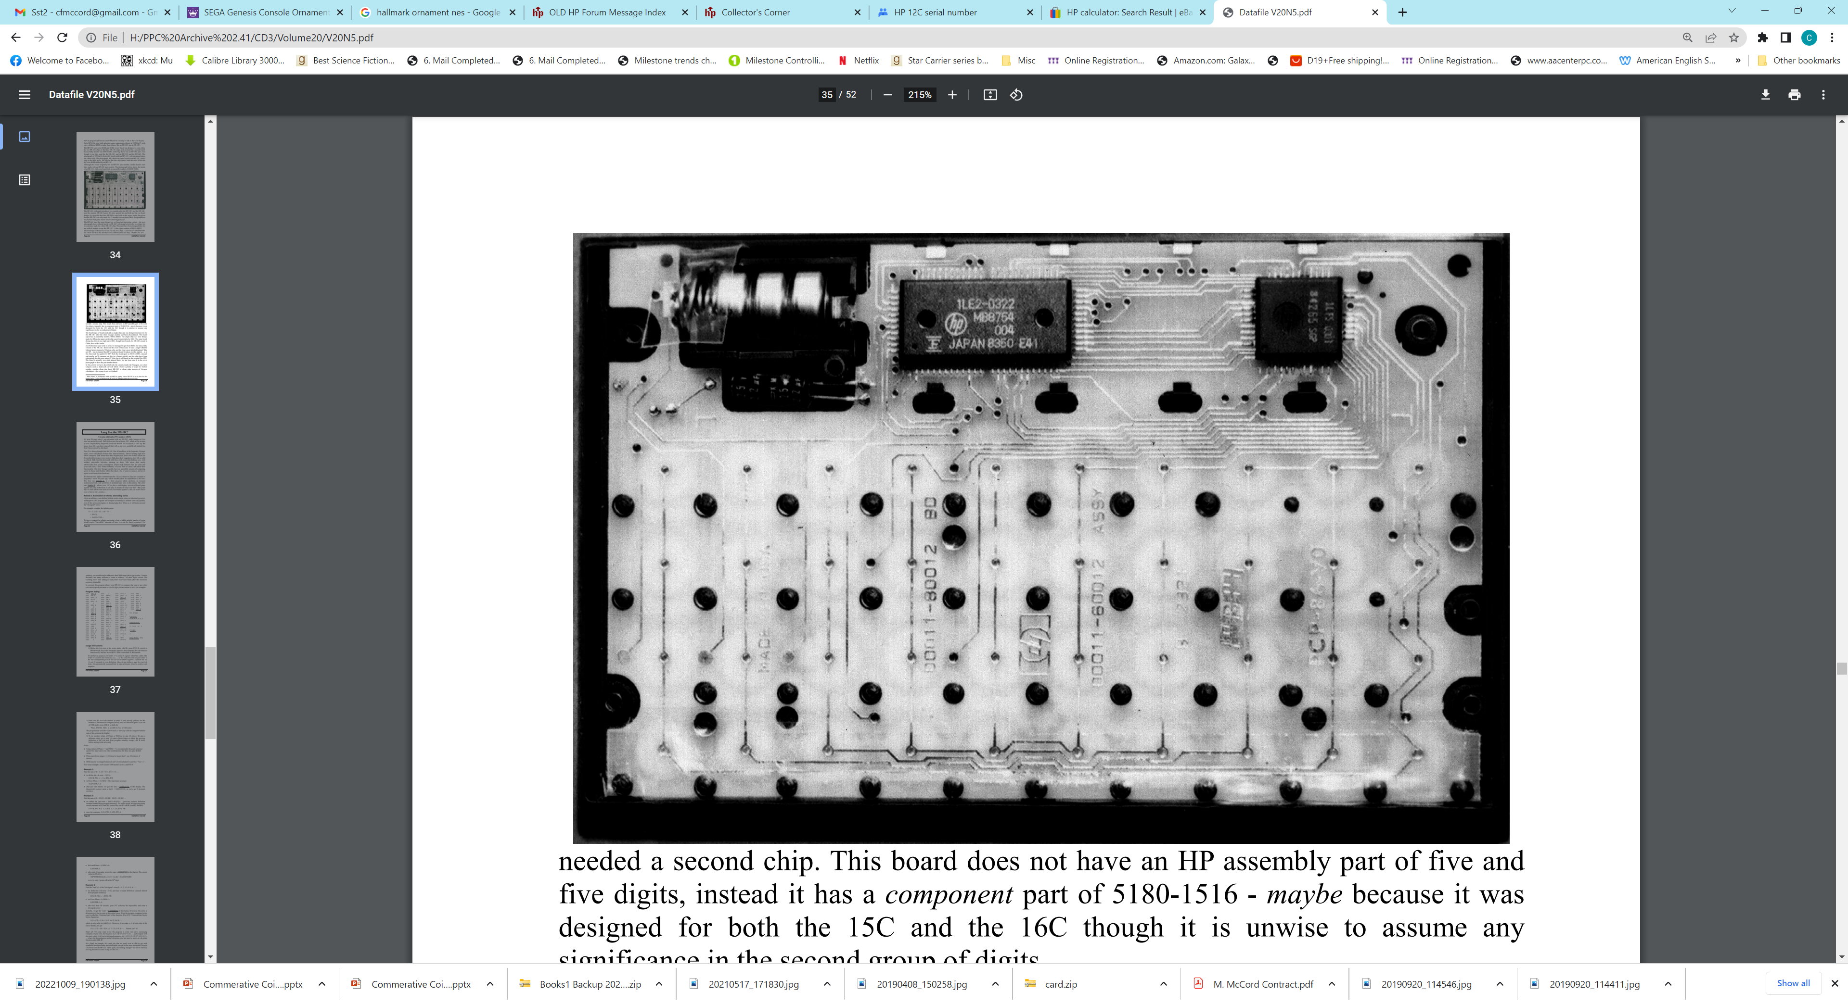
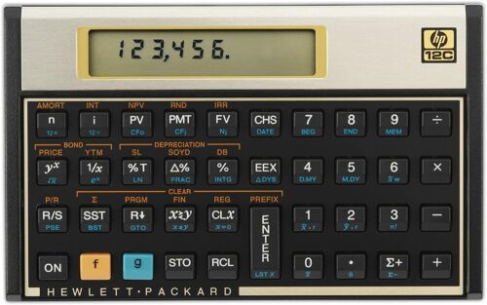
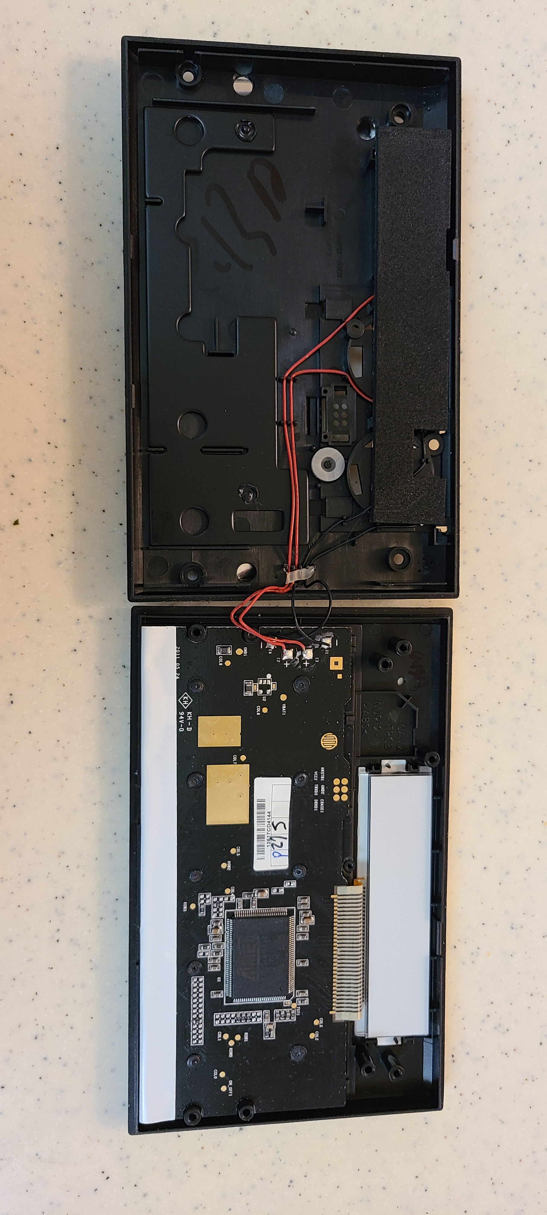
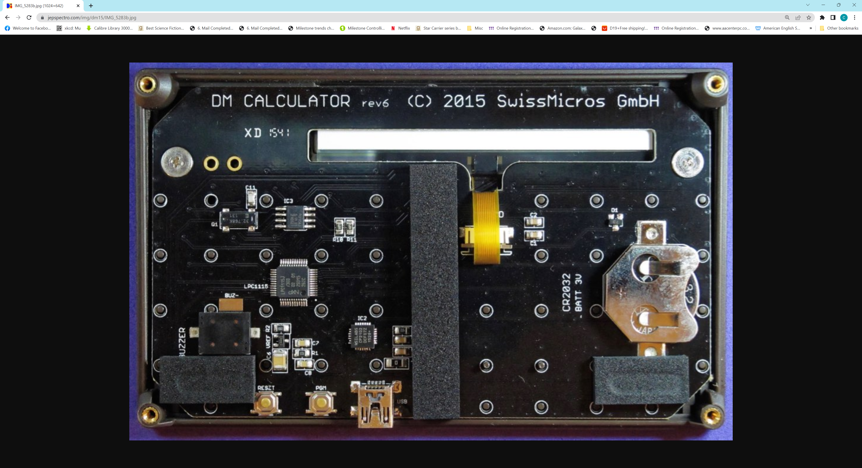
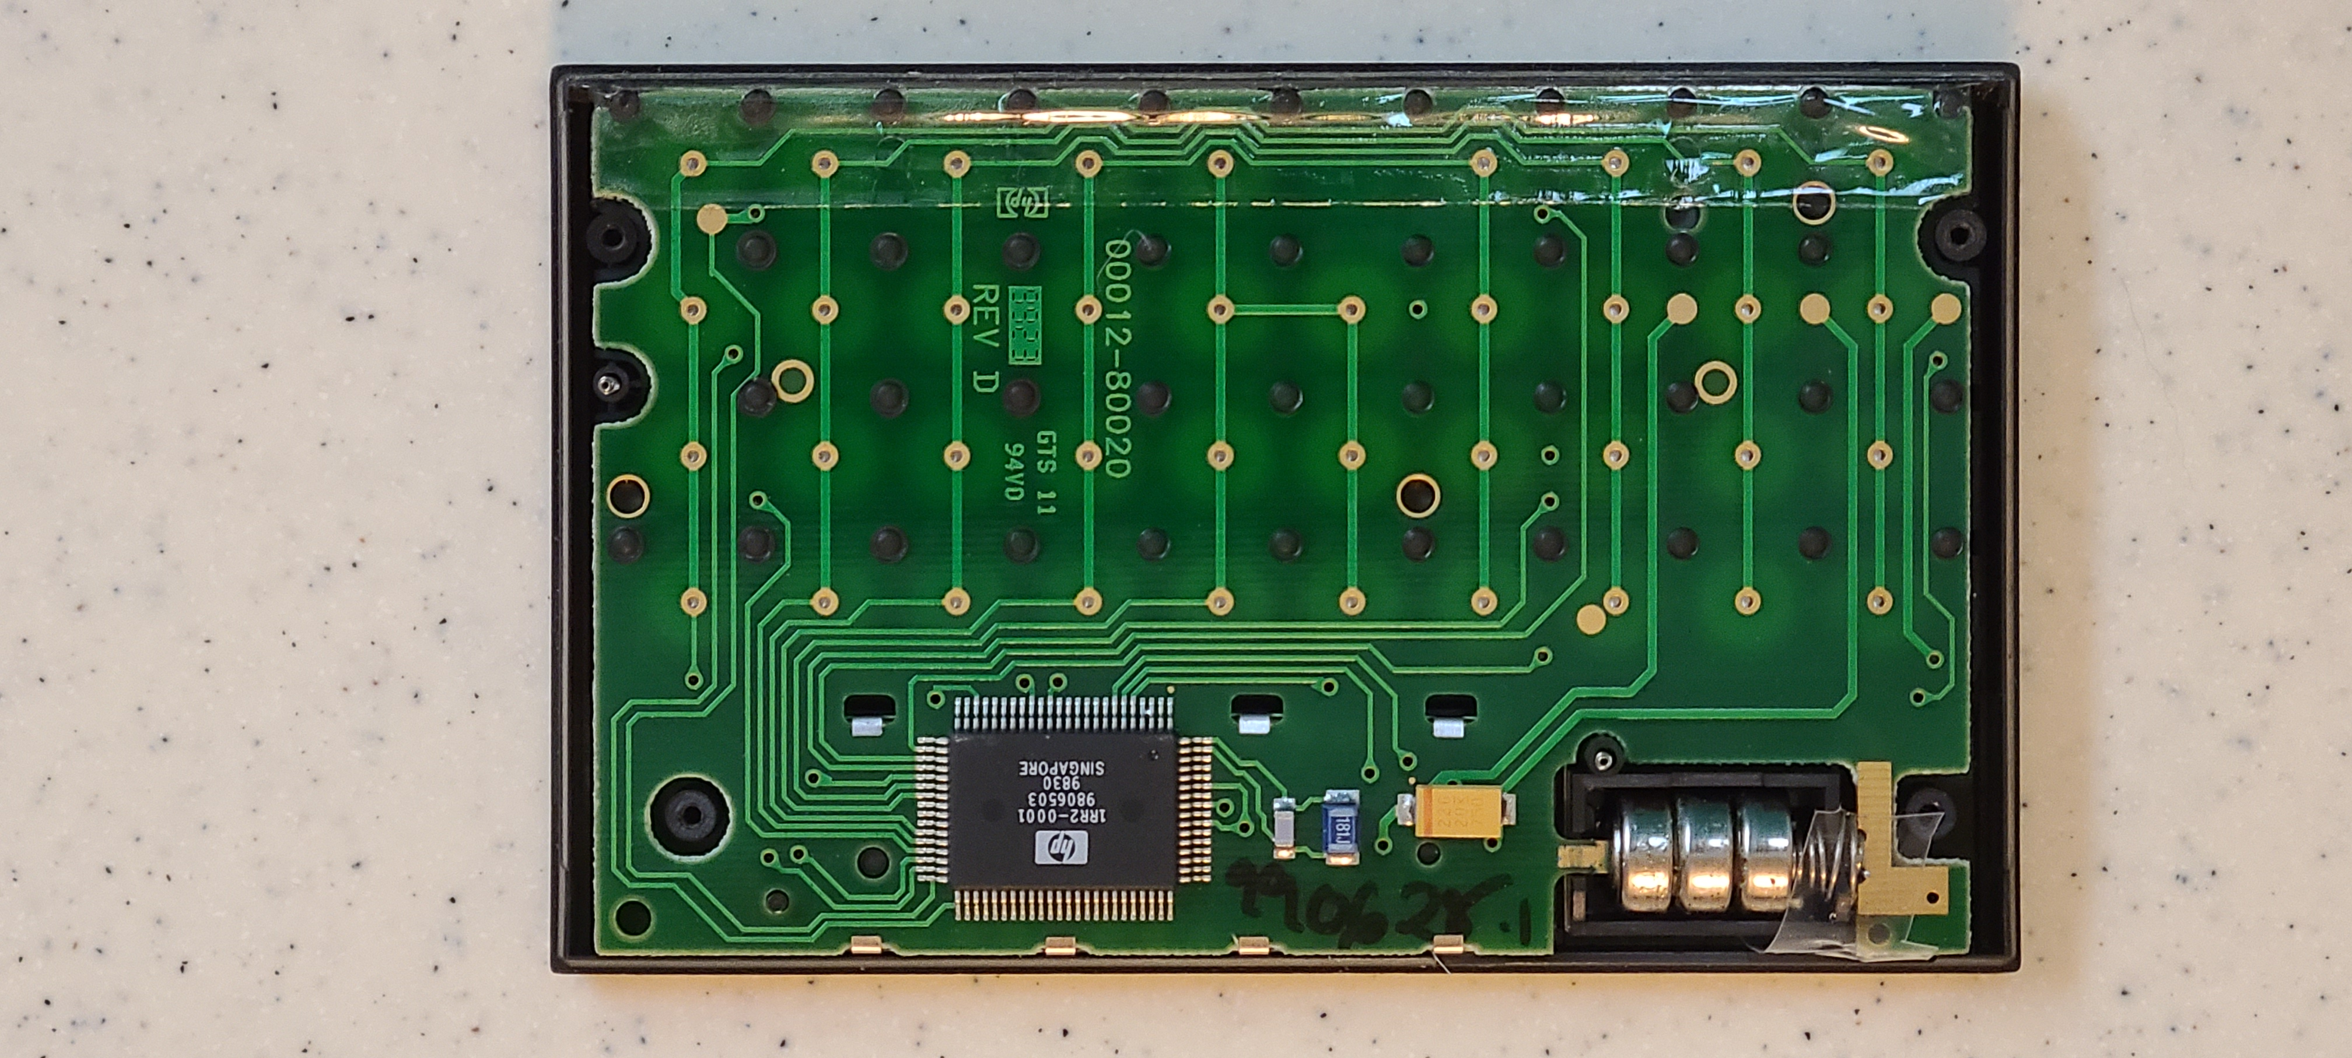
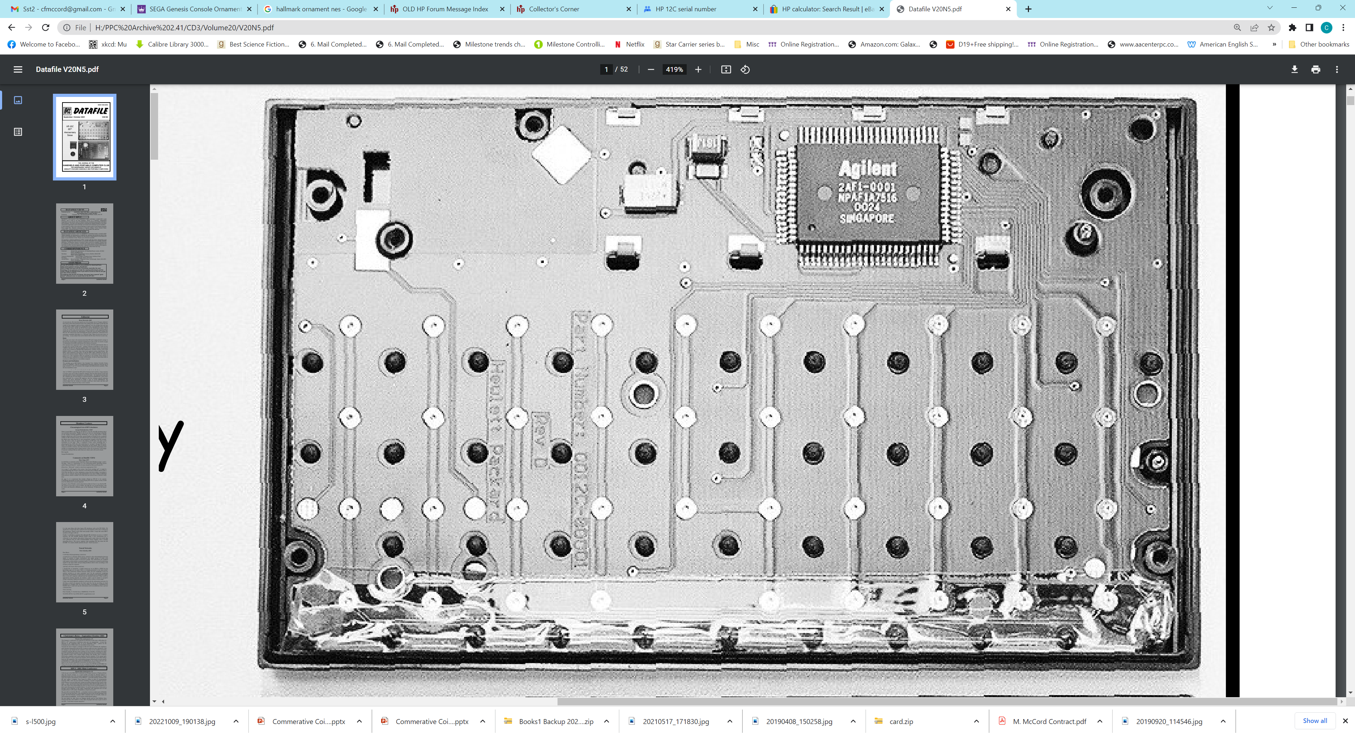
HP12C 1982wk18 USA 2218A04935
SST HP15
SST HP12 1982 USA 2222A#####
Post SST HP12
Post SST HP12
Voyager System
HP12C 1999wk29 Malaysia MY92902542
“Why do this? So far as the user is concerned, all HP-12Cs work the same way and give the same results. Yet to some HP fans, and hardware hackers, this is not the whole story – we want to know how it works – and how it changes.”
HP12C 2012 Invertec 4CY2320481
Swiss Micro DM15L
HP12C 2001wk17 China CN11700887
The HP-12C Project – Inside the Voyagers
Tony Duell, #788 and Włodek Mier-Jędrzejowicz', #9
Datafile V20N5
cfm
2022
Notes:
Voyager ancestry photo. B/W photos from Datafile articles. Nice quote!

Slide 25
HP12
HP12C
1999wk29
Malaysia
MY92902542
MY92902542

Slide 26
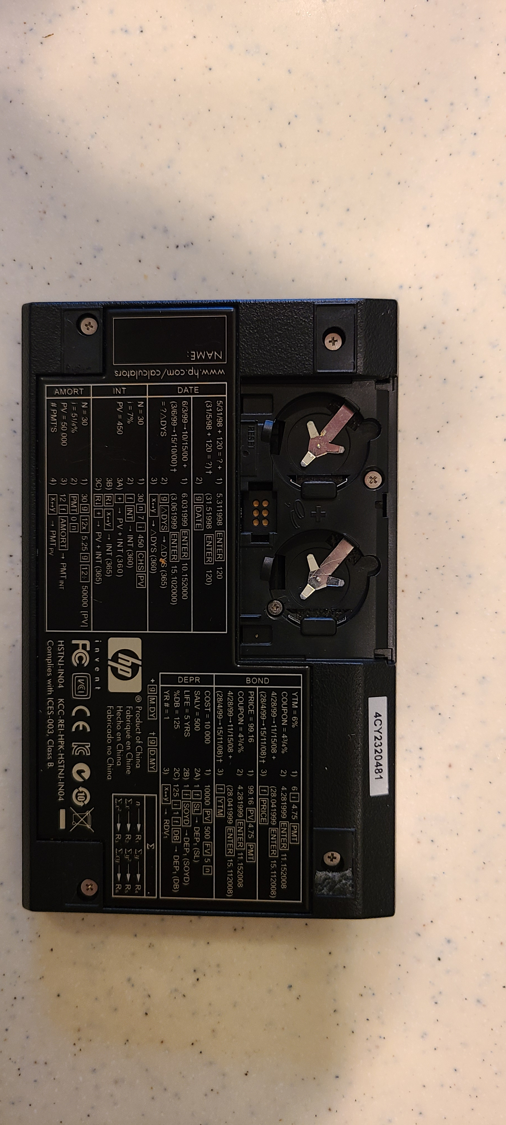
Post SST 12C
HP12C
2012 Invertec
4CY2320481
Conductive Rubber
Reset
Foam LCD Support
* Big THANK YOU to Bob Prosperi for this calculator!
Weight/ Back Stiffener
4 Battery Wires

Slide 27
Post SST 12C
Programming
Port?
1 Multi-layer
PCB
Flex connection to LCD
HP12C
2012 Invertec
4CY2320481
* ATMEL
128kb flash
6kb SRAM
7 Seg drv
USART
SPI
…
ATMEL AT91SAM7L128-AU
1213/1S7532*
Voltage Regulator +
2 SMT Resistors
33+ SMT
Components

Slide 28
DM15L
https://
jepspectro.com/
img/dm15/
IMG_5283b.jpg

Slide 29
Epilogue- HP Semiconductors
B3- fab for low leakage CMOS w/1 layer Poly, 1 layer Metal for calculators
B2- higher volume, lower defect density CMOS fab for more advanced nodes for WW HP product use
Offered foundry services (supercomputers, PC graphics chips, error correction, …)
HP Transitioned Internal CMOS ICs → Foundry service customer
Transitioned B2 Fab → Inkjet print head manufacturing
Internal CAD → Industry CAD

Slide 30
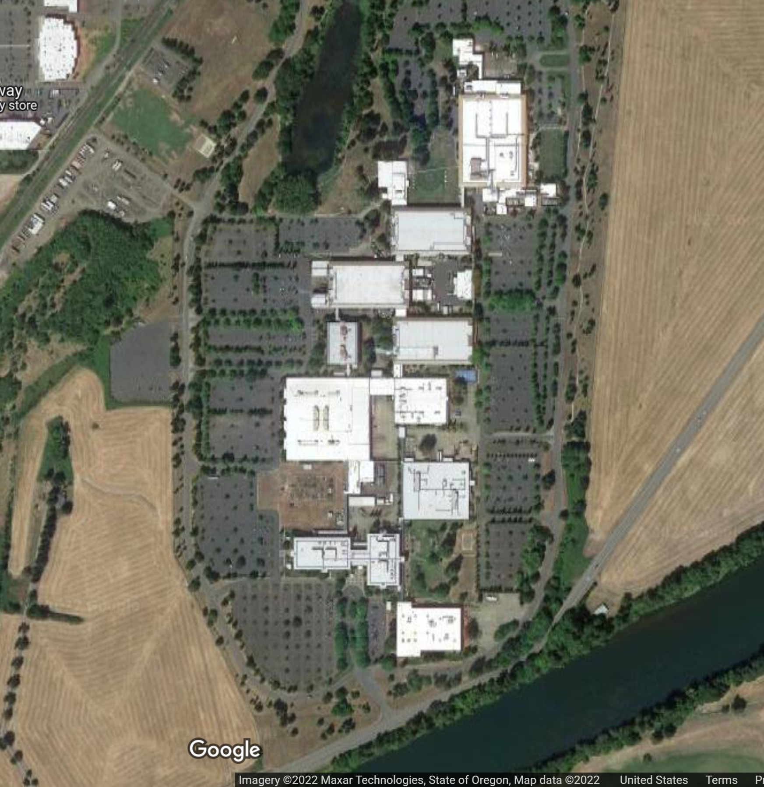
HP CV Site over time
In 1980 only B3 & B4, w/B5 in progress
B3, B4, B5 are all standard HP Bigfoot buildings
- B4: Front lobby
Cafeteria
Offices
Plastic Molding, CNC machines
Wave solder
PCB & Final Assembly
- B3: CMOS fab, ATE, Offices
- B5: Initially empty (played Frisbee)
Later
- C: dedicated Cafeteria built as site grew
- B2: super bigfoot fab and office space
Service had its own building
Even later
Other buildings as IJBU grew
At one time before Compaq acquisition Corvallis site was HP’s largest site
2
C
3
4
5
Service

Slide 31
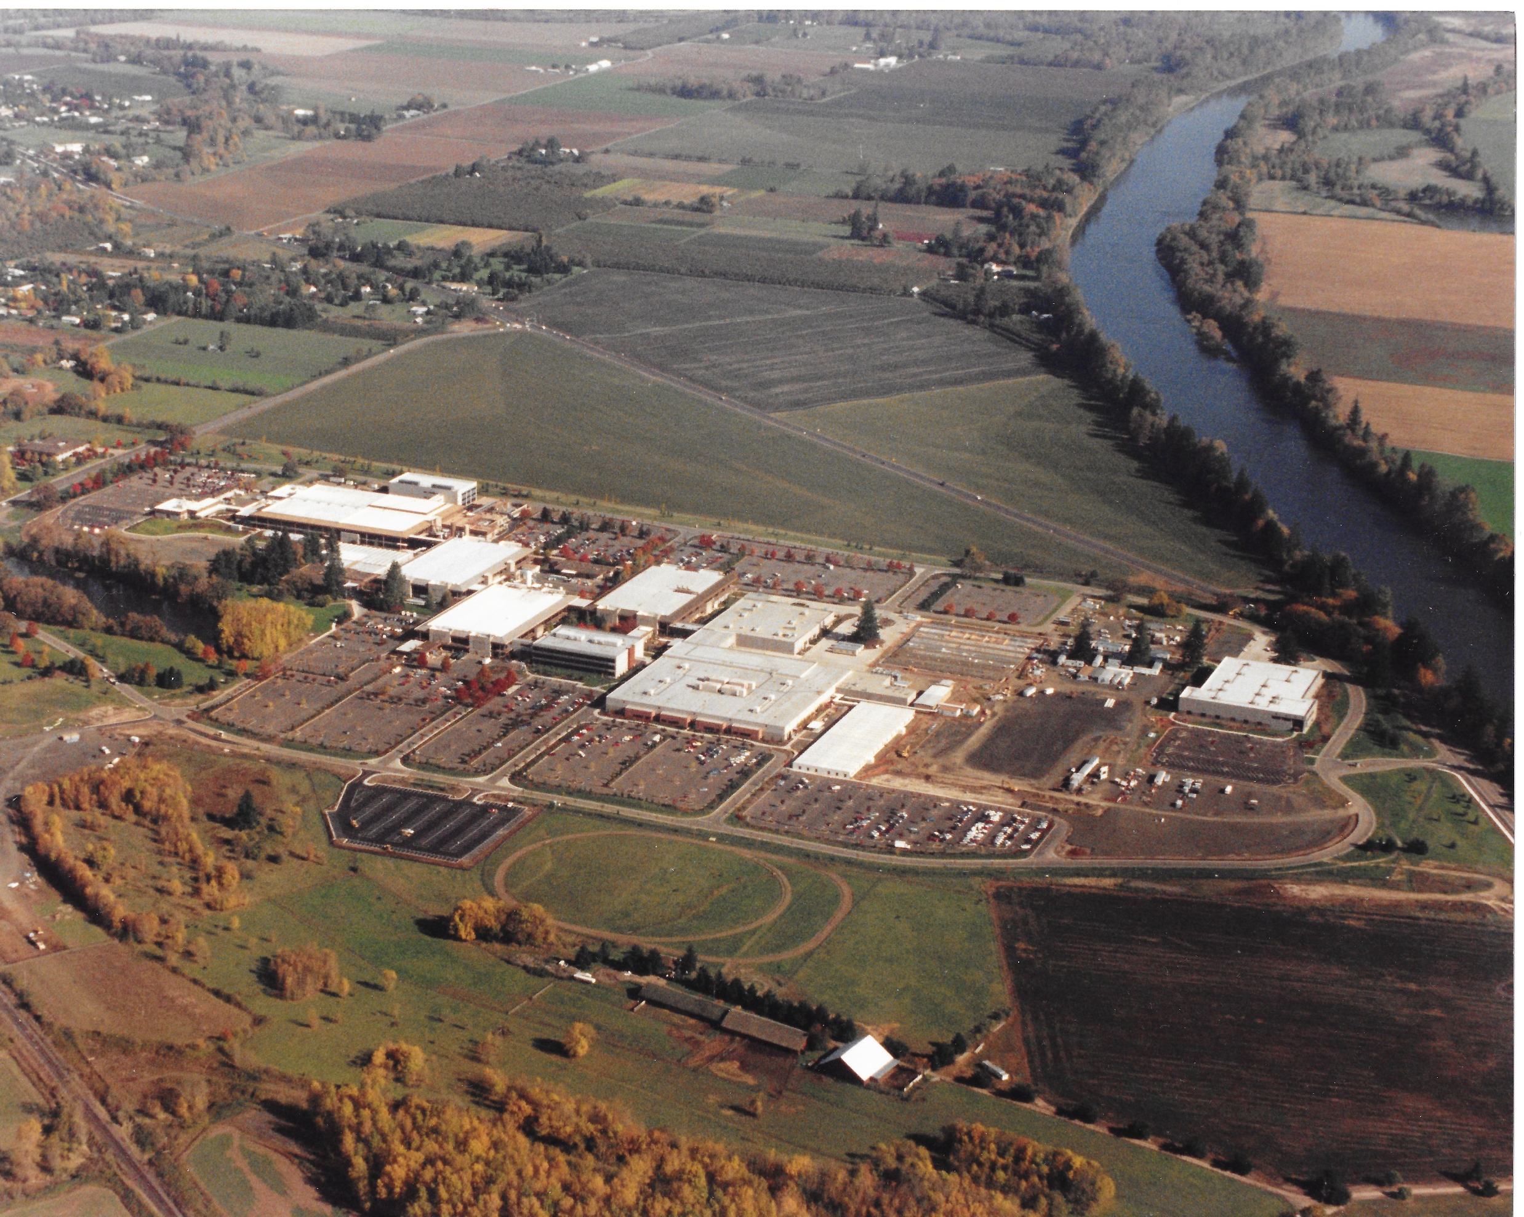

Slide 32
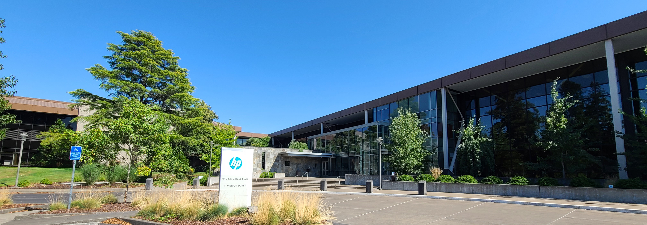
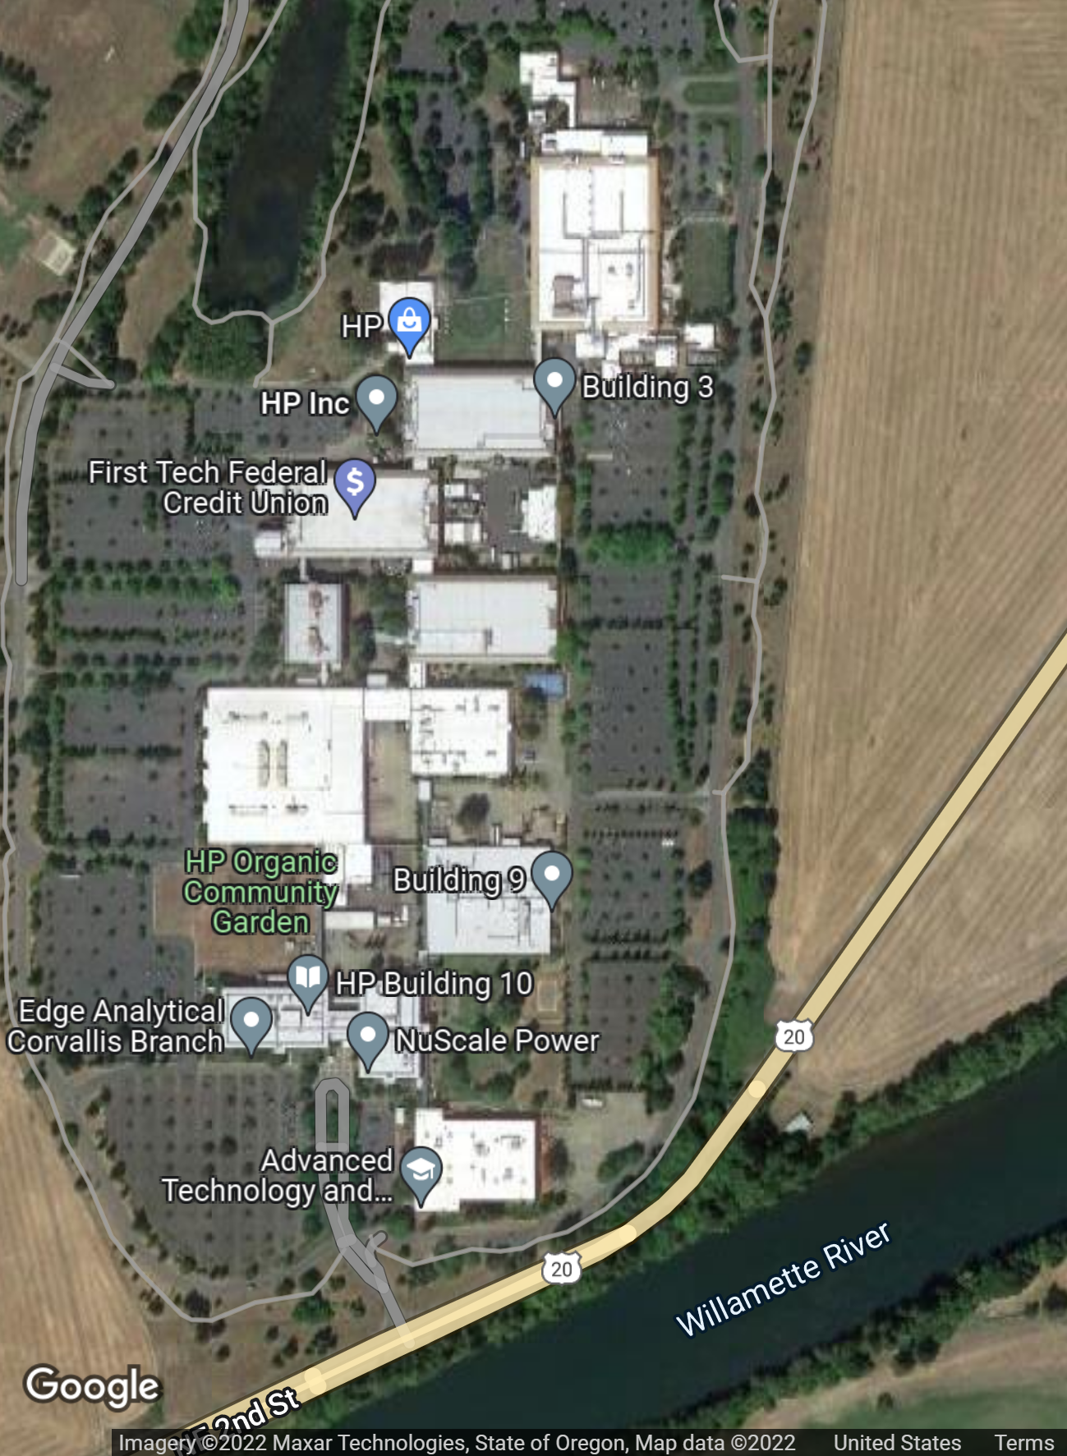
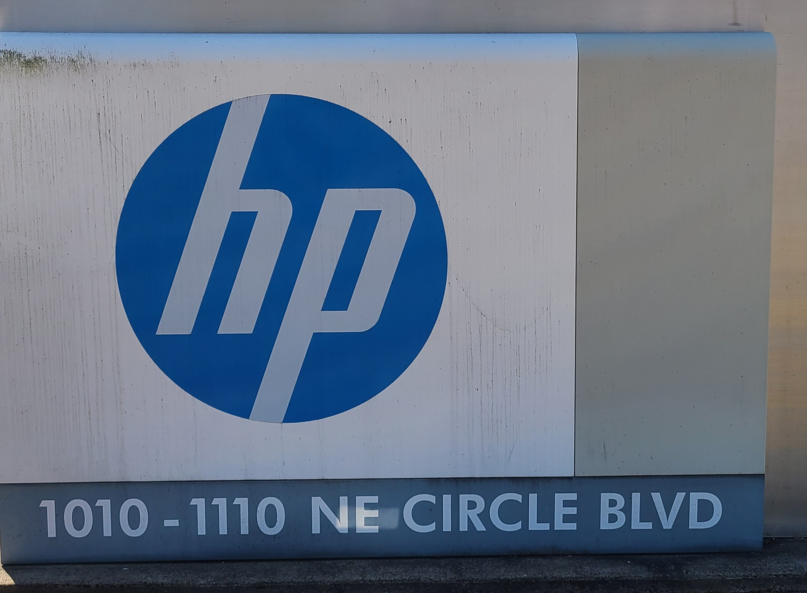
1010 NE Circle Blvd Site
Today
HP is still there, not occupying all the buildings
Site is now a business park
Demolished unused B1 office building

Slide 33
Cfm 2022
HP12C 1982wk18 USA 2218A04935
Post SST HP12
HP12C 1999wk29 Malaysia MY92902542
SST HP15
Post SST HP12
HP12C 2001wk17 China CN11700887
Voyager System
“Why do this? So far as the user is concerned, all HP-12Cs work the same way and give the same results. Yet to some HP fans, and hardware hackers, this is not the whole story – we want to know how it works – and how it changes.”
SST HP12 1982 USA 2222A#####
HP12C 2012 Invertec 4CY2320481
The HP-12C Project – Inside the Voyagers
Tony Duell, #788 and Włodek Mier-Jędrzejowicz', #9
Datafile V20N5

Slide 34
HP12C 1982wk18 USA 2218A04935
Post SST HP12
HP12C 2001wk17 China CN11700887
SST HP15
HP12C 1999wk29 Malaysia MY92902542
HP12C 2012 Invertec 4CY2320481
Voyager System
“Why do this? So far as the user is concerned, all HP-12Cs work the same way and give the same results. Yet to some HP fans, and hardware hackers, this is not the whole story – we want to know how it works – and how it changes.”
SST HP12 1982 USA 2222A#####
Swiss Micro DM15L
The HP-12C Project – Inside the Voyagers
Tony Duell, #788 and Włodek Mier-Jędrzejowicz', #9
Datafile V20N5
cfm
2022

Slide 35
cfm
2022
The HP-12C Project – Inside the Voyagers
Tony Duell, #788 and Włodek Mier-Jędrzejowicz', #9
Datafile V20N5
“Why do this? So far as the user is concerned, all HP-12Cs work the same way and give the same results. Yet to some HP fans, and hardware hackers, this is not the whole story – we want to know how it works – and how it changes.”
Post SST HP12
SST HP12 1982 USA 2222A#####
HP12C 2001wk17 China CN11700887
Swiss Micro DM15L
Voyager System
HP12C 1982wk18 USA 2218A04935
SST HP15
Post SST HP12
HP12C 1999wk29 Malaysia MY92902542
HP12C 2012 Invertec 4CY2320481

Slide 36
